Slide 1
Increasing Antenna Range (Penetration)and Intensity at Studs in Walls using
Plasma Lens Focusing
Dr. Ted Anderson Haleakala R & D, Inc.

Slide 2
Increasing Antenna Range (Penetration) by
Increasing Directivity
Friis Transmission Line Equation shows that Range increases as the square root of directivity of the transmitting antenna.
Directivity can be increased by
plasma lens focusing.

Slide 3
New Range in Terms of Directivity of Stud Finder Antenna
Of course the new range will increase even more if the directivities of both the transmitting and receiving antenna is increased by plasma lens focusing.
1
⎛ NewDirectivity ⎞
2
NewRange = OldRange⎜ ⎟
OldDirectivity
⎝
⎠
4π
Directivity =
BeamSolidAngle

Slide 4
Beam Solid Angle
BeamSolidAngle = θ₁θ₂
θ₁ = HalfPowerBeamWidthInOnePlane
θ₂ = HalfPowerBeamWidthInPerpendiclarPlane

Slide 5
Some Physics of Plasma
Transparency and Reflection
The plasma frequency is proportional to the density of unbound electrons in the plasma or the amount of ionization in the plasma. The plasma frequency sometimes referred to a cutoff frequency is defined as:
4πn_{e} e
2
ω =
p
me
where n_{e}
is the density of unbound electrons, e is the charge on the
electron, and me is the mass of an electron
If the incident RF frequency on the plasma is greater than the plasma frequency
the EM radiation passes through the plasma and the plasma is transparent.
ω > ω _{p}
When the opposite is true, plasma acts as a metal, and transmits and receives
microwave radiation.

Slide 6
Definition of Plasma Cutoff
Definition of cutoff: the displacement current and the electron current cancel when electromagnetic waves impinge on a plasma surface. The electromagnetic waves are cutoff from penetrating the plasma
When the plasma frequency is above cutoff, the electromagnetic waves are reflected from the plasma
– The EM waves are cutoff from transmission through the plasma.
When the plasma frequency is below cutoff, the electromagnetic waves pass through the plasma.

Slide 7
Steering and Focusing when the
Plasma Density is Below Cutoff.
Steering and focusing can also be achieved when the
Plasma Density is below cutoff.
  The speed of electromagnetic waves in a plasma is a function of plasma density.
An effective Snells Law causes refraction of electromagnetic waves passing through a plasma of variable density (plasma density varying from container to container containing plasma)
  this enables focusing of the electromagnetic waves
  decreases beamwidths
  increases directivity
  increases antenna range
The steering and focusing of by the plasma can occur on
a time scale of milliseconds.

Slide 8
Steering and Focusing when the
Plasma Density is Below Cutoff
Incident RF waves on the left ( see next slide) impinge on plasma tubes with different densities but with the plasma densities below cutoff.
Focusing or steering can be achieved depending on how the plasma densities are varied from tube to tube.

Slide 9
Focusing when the Plasma Density is Below
Cutoff.
By increasing the plasma density up and down from the bore site plasma tube we obtain a convergent plasma lens. This increases directivity.
Focused and/or steered Microwaves

Slide 10
Reconfigurable Beam Lensing (beam focusing and spreading) and Reconfigurable Steering with Refraction through a Plasma
Dr. Ted Anderson; Haleakala R&D; Proprietary

Slide 11
Beam Lensing and Steering with Refraction
Antenna beam focusing, beam spreading, and beam
steering using refraction of RF waves in a plasma.
This is our first iteration of the plasma lens work and it can only improve. We found it was easier to show the lensing effects of plasma at 24 GHz since the size and shape of COTS plasma tubes are amenable to a 24 GHz.
These effects all scale according to wavelength.
Cylindrical annular rings of plasma are the best way to control the plasma density variations of plasma to optimize the engineering effects of plasma refraction to control beam focusing, beam spreading, and beam steering
Dr. Ted Anderson; Haleakala R&D; Proprietary

Slide 12
Beam Lensing and Steering with
Refraction
We have demonstrated the ability to use a plasma for manipulation of antenna signals by focusing a wide beam into a more narrow beam and also by steering the beam.
Shows the experimental set-up for beam steering and lensing. A narrow-beam 24 GHz signal is directed into the side of a 1.5 inch diameter plasma tube.
Metal shields are on both sides of the plasma tube to block any
extraneous signals from passing through the plasma tube.
If the electron plasma frequency (wp) of the plasma is lower than the signal frequency (24 GHz in our case) then the phase velocity (V_{p}) of the signal is faster than the speed of light in a vacuum.
•
V_{p} = C / (1- (wp/w)^2)^{1/2}
(ω
= 2πf)
Dr. Ted Anderson; Haleakala R&D; Proprietary

Slide 13
Beam Lensing and Steering with
Refraction
This change in velocity of the signal inside the plasma results in a lensing effect if the beam passes through varying lengths of plasma similar to light passing through glass of varying thickness to make a lens.
But there is an important and interesting difference between an ordinary lens made of glass or plastic and a plasma lens:
The glass lens slows-down the signal while a plasma lens speeds-up the signal.
Therefore a convex glass lens focuses a signal to a point while a convex plasma diverges the signal similar to a concave glass lens that diverges the signal while a concave plasma lens focuses to a point.
We have built converging and diverging plasma lenses using plasma tubes. A single plasma tube with the beam passing through its diameter acts as a diverging plasma lens and two plasma tube side-by-side form a converging (focusing) lens.
Note: Plasma focusing lenses are concave and plasma spreading lenses are convex. The terms concave and convex in plasma lenses are opposite of the terms of lenses in optics.
Dr. Ted Anderson; Haleakala R&D; Proprietary

Slide 14
Beam Lensing and Steering with
Refraction
We have built the focusing set-up for beam shown.
A 24 GHz, 5 mW Gunn diode is used as the microwave source with the signal radiating from the open waveguide, which gives a unfocused microwave output.
This setup allows us to focus the beam in the forward direction resulting in a gain of 2 (3 dB).
This is our first iteration of the engineering of plasma lensing and it can only get better.
Dr. Ted Anderson; Haleakala R&D; Proprietary

Slide 15
Beam Lensing and Steering with
Refraction
We are the only group that has utilized a pulsed high voltage power supply to give a much higher average plasma density.
We show an interesting effect caused by the initial high plasma density at the time of the pulse followed by a decay in plasma density as ions drift to the wall.
Dr. Ted Anderson; Haleakala R&D; Proprietary
110

Slide 16
Beam Lensing and Steering with
Refraction
In regard to a relatively lower pulse current:
  The focusing effect occurs immediately after the current
pulse but stops as current decreases.
  Using a higher current (8 A), that best focusing occurs later after the pulse. These figures indicate that focusing can be “tuned” by changing density of the plasma inside the tube.
This ability to tune the focusing of a RF beam is very useful because the same lensing structure can be used with different frequencies and plasma densities to vary focal length as needed.
Dr. Ted Anderson; Haleakala R&D; Proprietary

Slide 17
24 GH Diode Transmitter
Fluorescent Lamps 1.5 dia.
Dr. Ted Anderson; Haleakala R&D; Proprietary

Slide 18
Horn with plastic lens
24 GHz Transmitter

Slide 19
HV Pulsing Circuit
24 Ghz Transmitter
Horn with collimating lens
-90 deg
90 deg
Turntable
1.5 in. dia. Fluorescent Lamp
Aluminum Shields
0 deg
Keithley Micro- Voltmeter
Wire Stub
Microwave diode Detector

Slide 20
Beam Focusing with Plasma Lenses

Slide 21

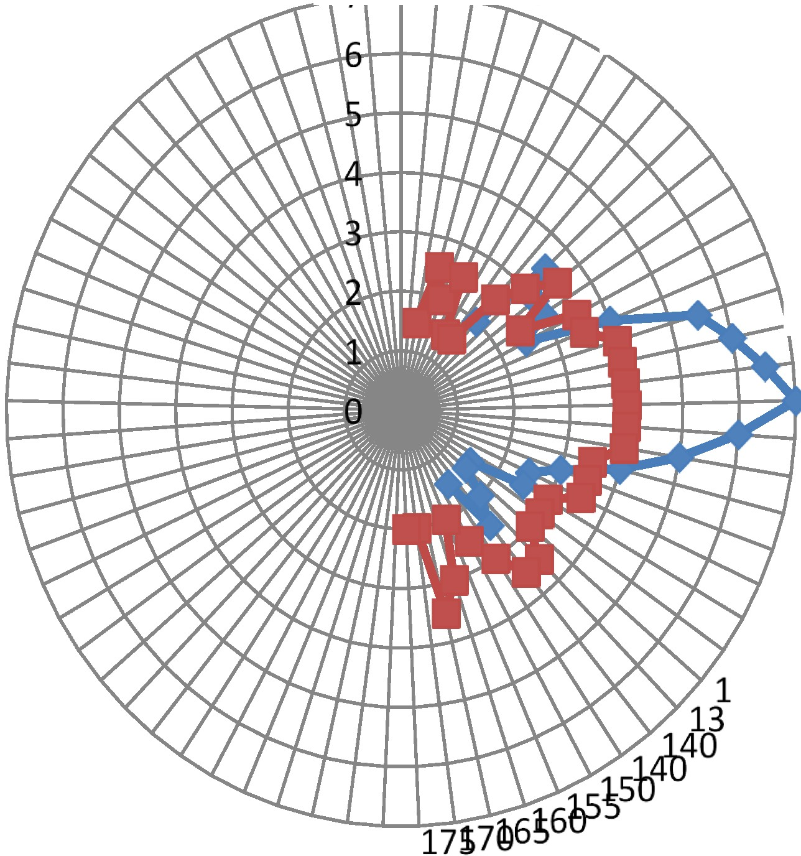
0
.l..r--r-.,..::; ,1J 01520
2 540
45_{so}
55
60
65
70
75
. 80
85
--1---t- 90
---r- 95
100
105
110
115
120
125
30
5
24 GHz beam focus with plasma. Red line is with no plasma. Blue line is with plasma. Note that the plasma focus increases beam amplitude by a factor of two compared to no plasma (,....,3 dB gain)

Slide 22
Beam Lensing and Steering with
Refraction
In the antenna beam focusing experiment, the beam passes through (and between) two side-by- side fluorescent bulbs.
The flat trace at the bottom of the screen is the zero-level for the microwave signal as detected by an 18-26 GHz diode detector.
The flat trace near the middle of the screen is the microwave signal with no plasma.
The top trace shows the effect on the microwave beam caused by refraction and focusing caused by the plasma inside the tubes.
Dr. Ted Anderson; Haleakala R&D; Proprietary

Slide 23
Beam Lensing and Steering with
Refraction
The fast drop in amplitude (left of screen) coincides
with a short current pulse (4 A, 5 μs).
This relatively high current pulse produces a high plasma density that reflects most of the 24 GHz beam.
The plasma ionizing current ends after 5 μs, but the plasma ion density takes much longer ( 1 ms) to decay; resulting in the increasing amplitude with time shown in the figure.
The maximum signal amplitude (right side of trace) occurs when plasma density is optimum for focus of the beam; and gives a gain compared to unfocused signal of a factor of two (3 dB).

Slide 24
Beam Lensing and Steering with
Refraction
We show the focusing effect of a relatively lower pulsed current (3 A). The beginning of each drop in signal level corresponds to the current pulse; resulting in a dip in signal level (reflection) that quickly recovers to more optimum focusing as plasma density decreases.

Slide 25
Beam Lensing and Steering with
Refraction
Peak Current in pulse vs DC from power supply
Peak ionizing currents are rather high (2-20 A), but current required from the DC power supply is much lower:
A 3 A pulse requires 15 mA DC from power supply.
A 10 A pulse requires 40 mA DC from power supply.
120

Slide 26
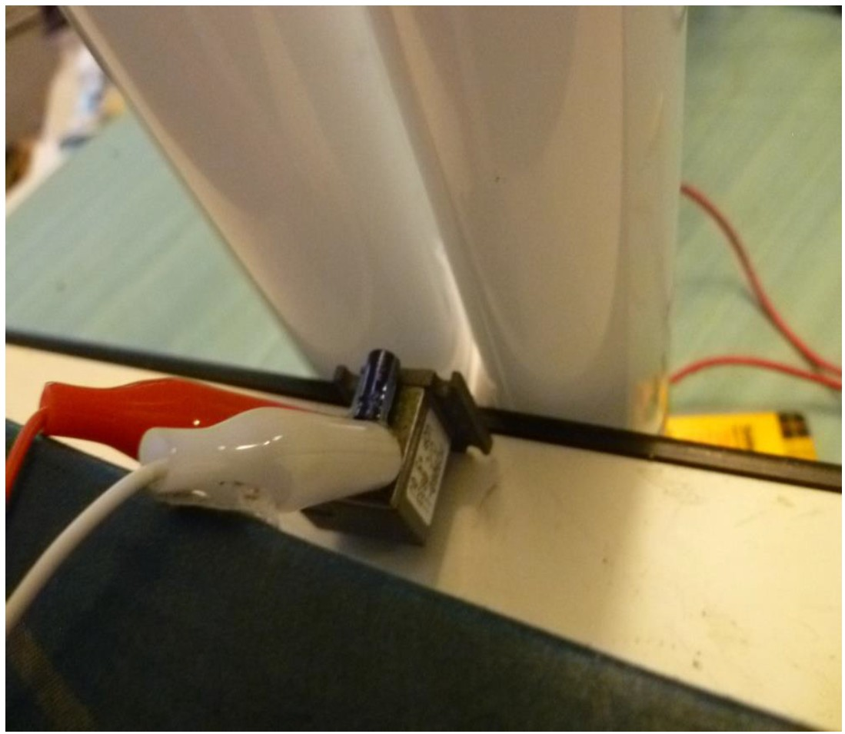
. Plasma focusing experimental setup. Gunn diode 24 GHz transmitter with fluorescent tubes
used for plasma beam focus.
Dr. Ted Anderson; Haleakala R&D; Proprietary

Slide 27
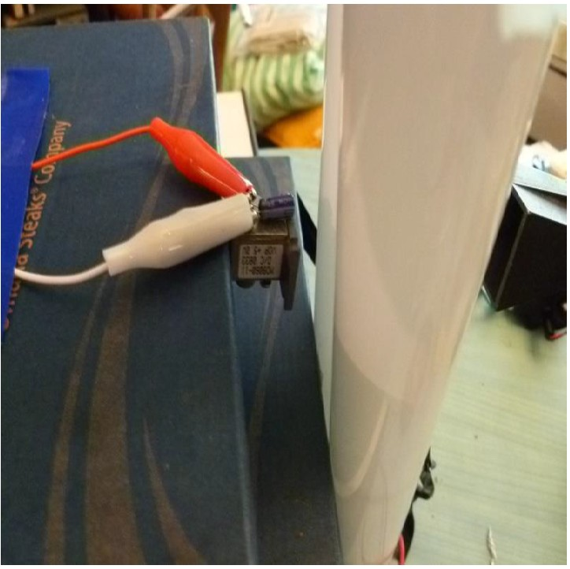
. Plasma focusing experimental setup. Gunn diode 24 GHz transmitter with fluorescent tubes
used for plasma beam focus.
Dr. Ted Anderson; Haleakala R&D; Proprietary

Slide 28
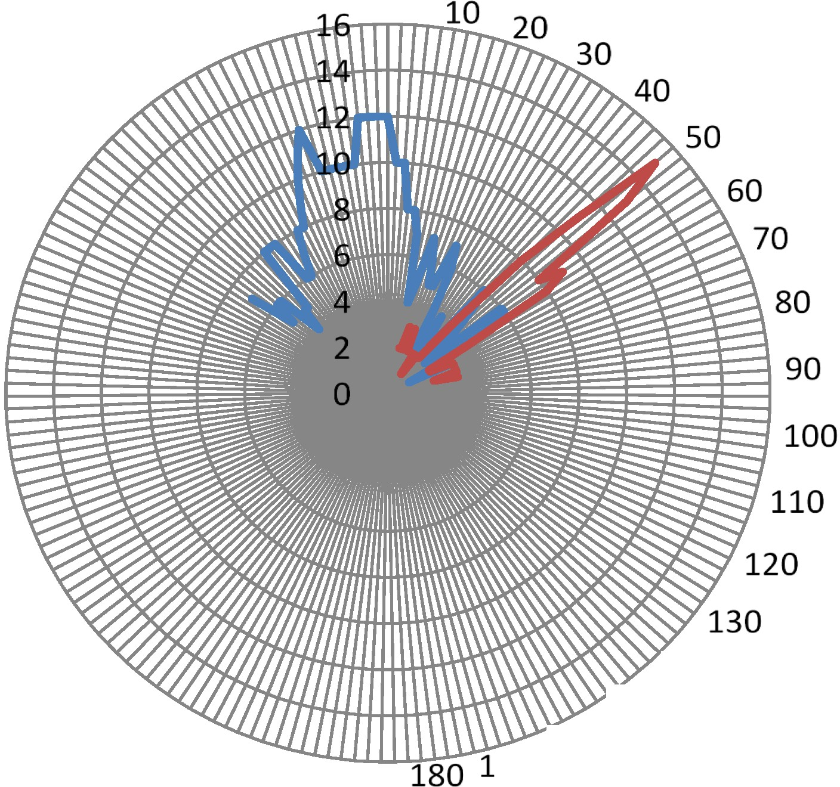
-
-
series 1 series2
140
150
70 160
Plasma Beam steering. Beam is steered "'45 degrees clockwise.
Blue line: No plasma; Red line: 8 A peak ionizing current.
Dr. Ted Anderson; Haleakala R&D; Proprietary

Slide 29
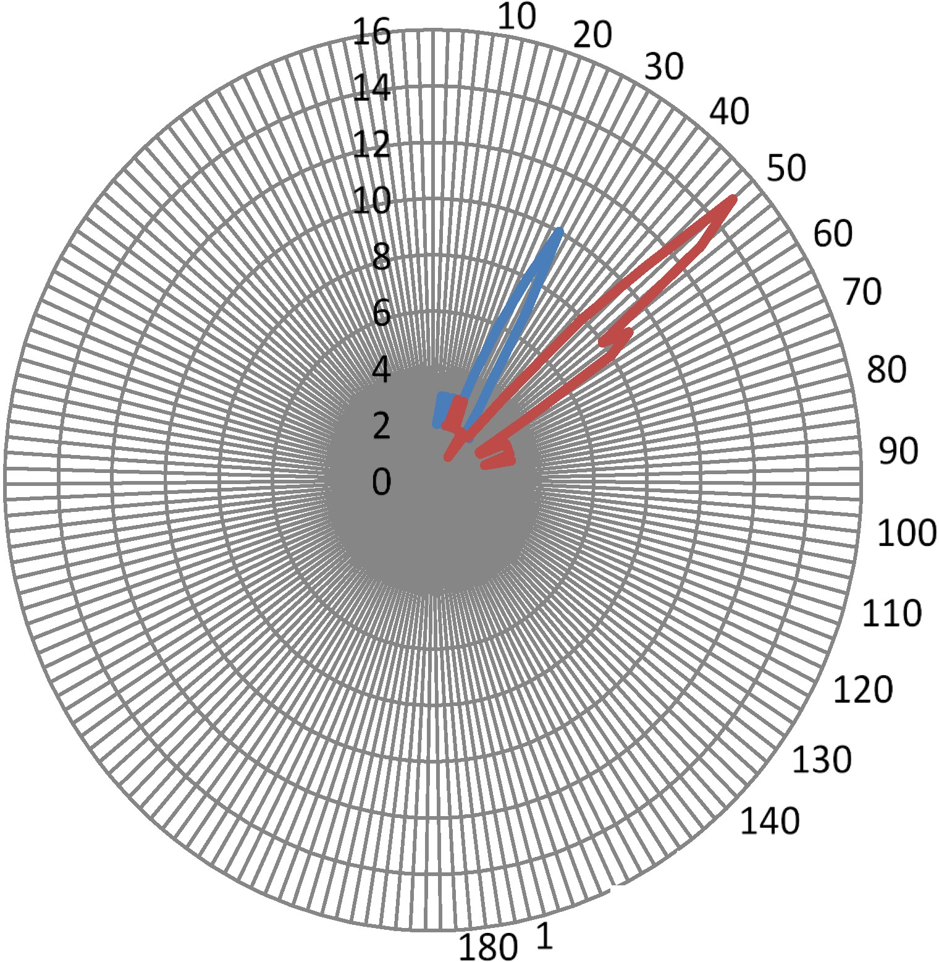
--series 1
--series 2
150
70 160
Beam steering for two different plasma ionizing currents.
Blue line: 5 A peak. Red line: 8 A peak
Dr. Ted Anderson; Haleakala R&D; Proprietary

Slide 30
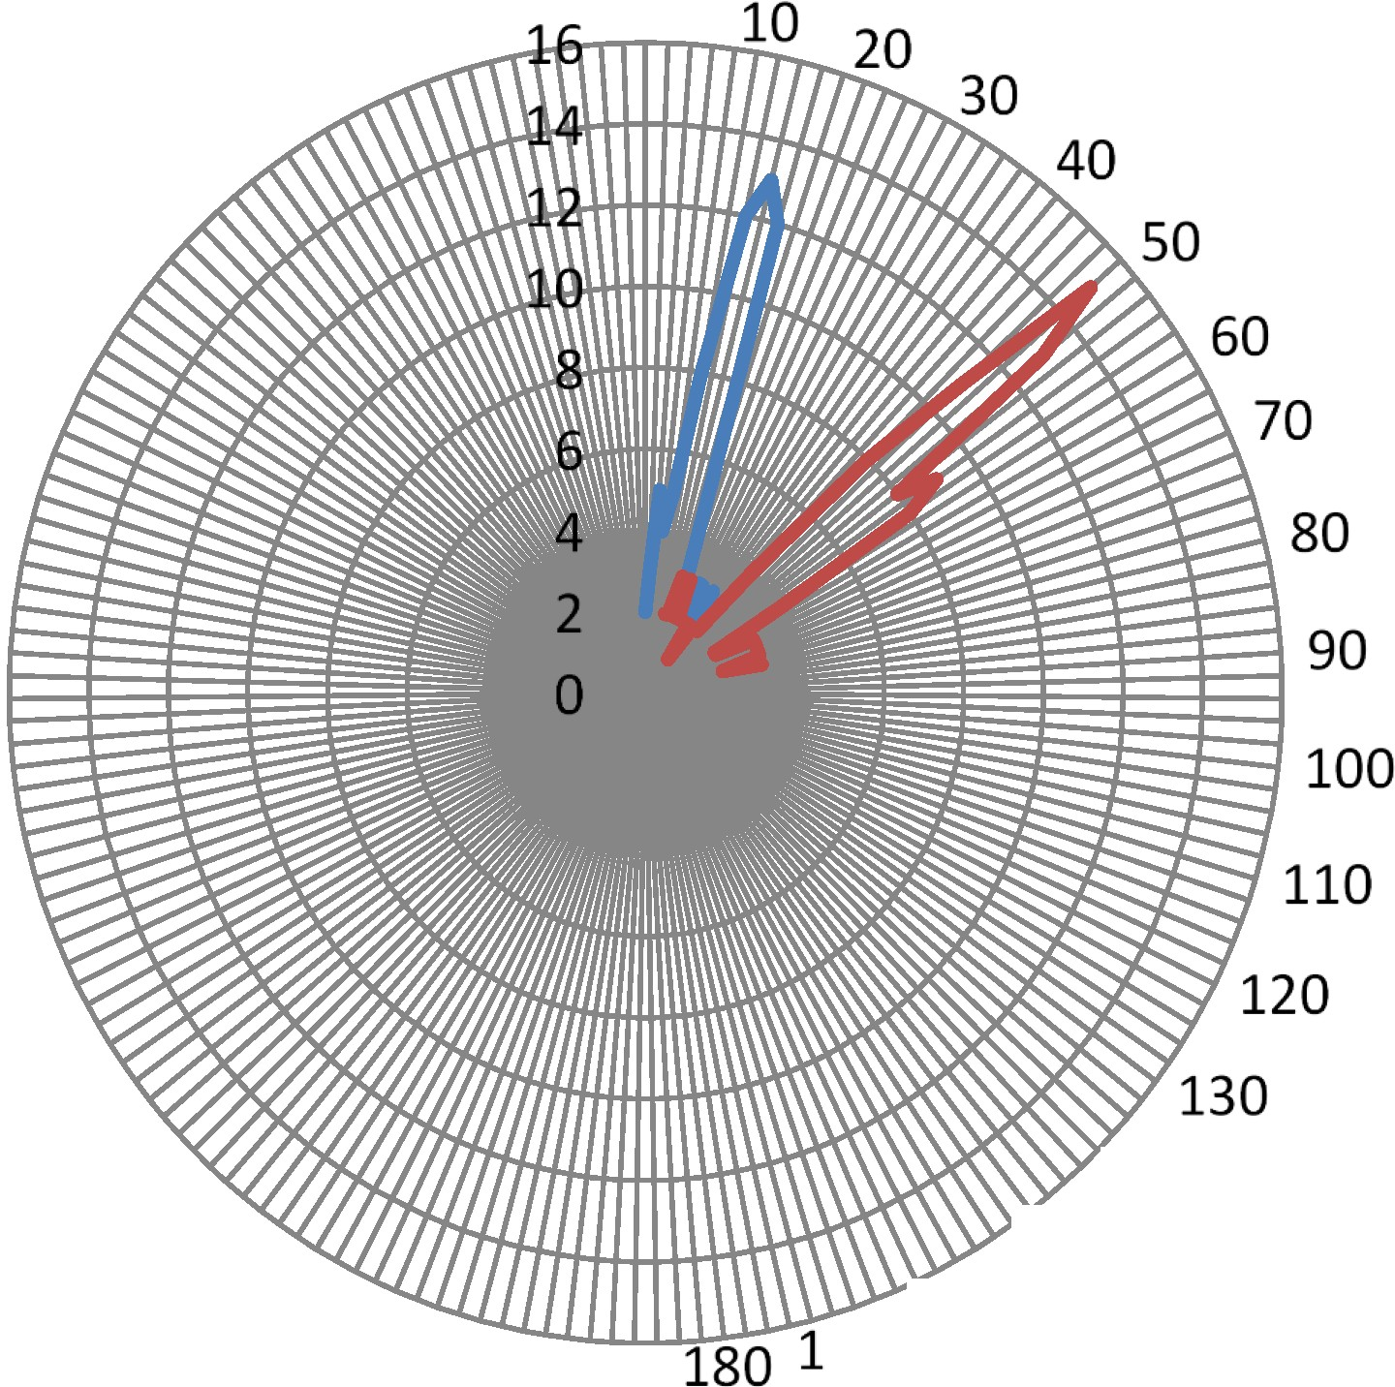
-
-
series 1
Series 2
140
150
70 160
Beam steering for two different plasma ionizing currents,
Blue line: 3 A peak. Red line: 8 A peak
Dr. Ted Anderson; Haleakala R&D; Proprietary

Slide 31
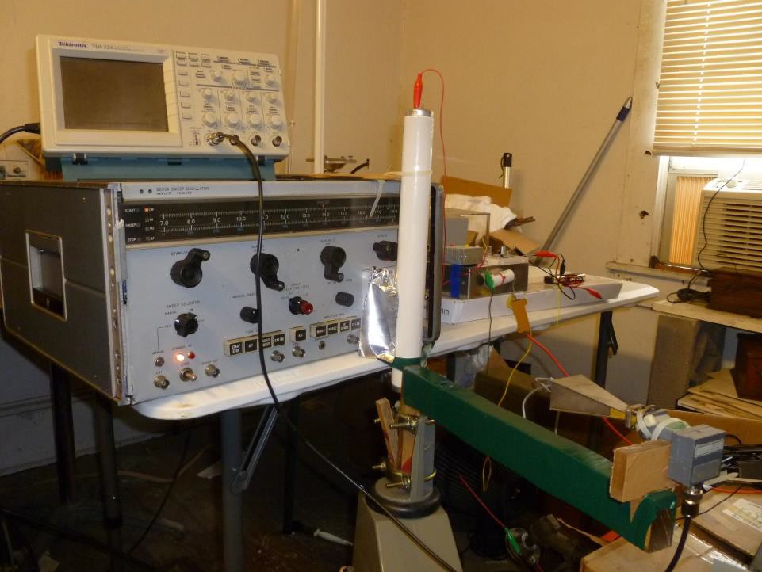
Plasma beam steering experiment. Antenna rotator with holder (green) and receiver horn / detector is in the foreground. The oscilloscope used to monitor the signal waveform is on top
of the HP signal generator. The solid state pulser is to the right of the signal generator.

Slide 32
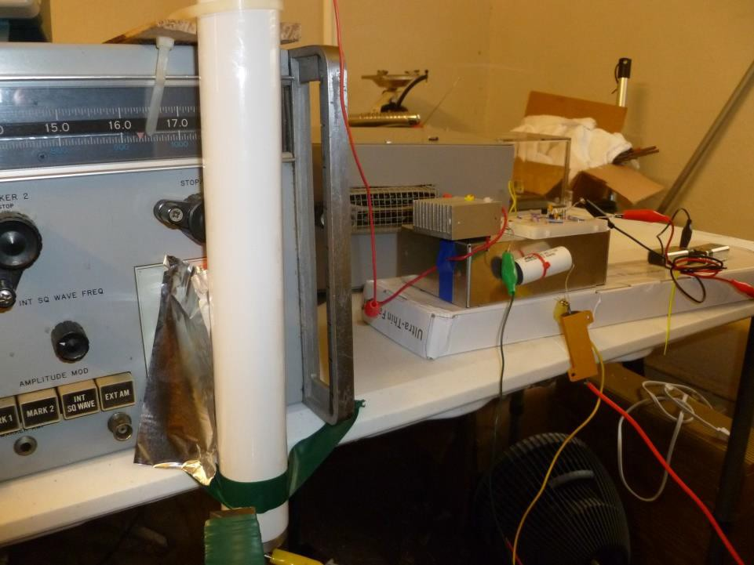
Fluorescent plasma tube is located in front of the output waveguide on the HP signal generator. Aluminum shield on left of tube prevents stray RF from bypassing the plasma. High voltage pulser is on the right.
Dr. Ted Anderson; Haleakala R&D; Proprietary

Slide 33
Refraction for steering and
focusing in a plasma
Refraction in a plasma depends on:
  Plasma density
  Path length
  Gradient of plasma density
Good results above 23 GHz
Made custom made tube and refraction worked
well at 10 GHz.
Continue work on refraction for focusing and
steering at 2.4 GHz
Dr. Ted Anderson; Haleakala R&D; Proprietary0

Slide 34
10GHz (X-Band) crystal detector
Signal Path
Angle of Deflection
Custom Plasma Antenna Tube (3 in. dia)
10 GHz Klystron Transmitter
Schematic layout of microwave signal deflection test. Custom plasma tube with 300 micron pressure argon backfill.
Dr. Ted Anderson; Haleakala R&D; Proprietary

Slide 35
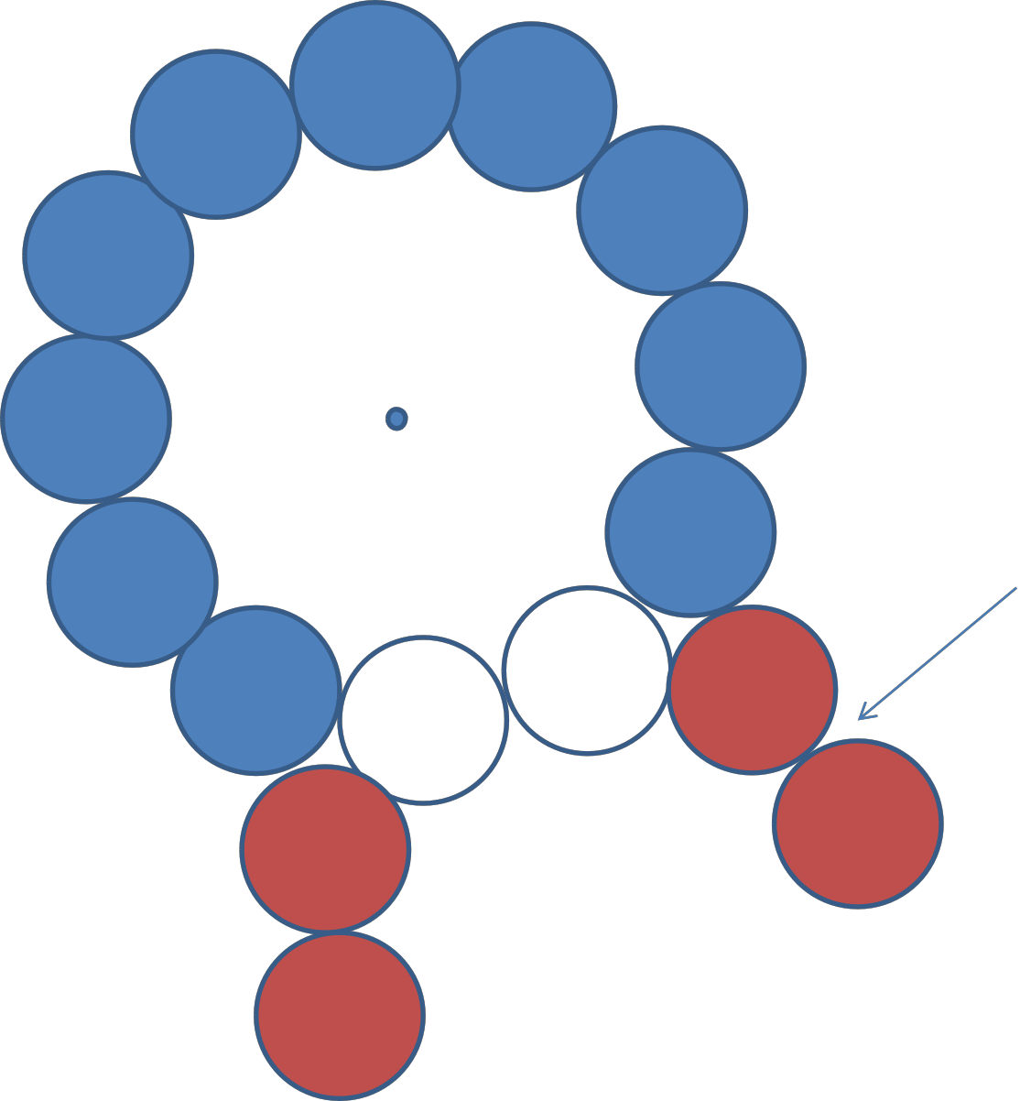
Tubes with lower density added to
focus.
Schematic of tube layout used to experiment with beam focusing.
Dr. Ted Anderson; Haleakala R&D; Proprietary

Slide 36
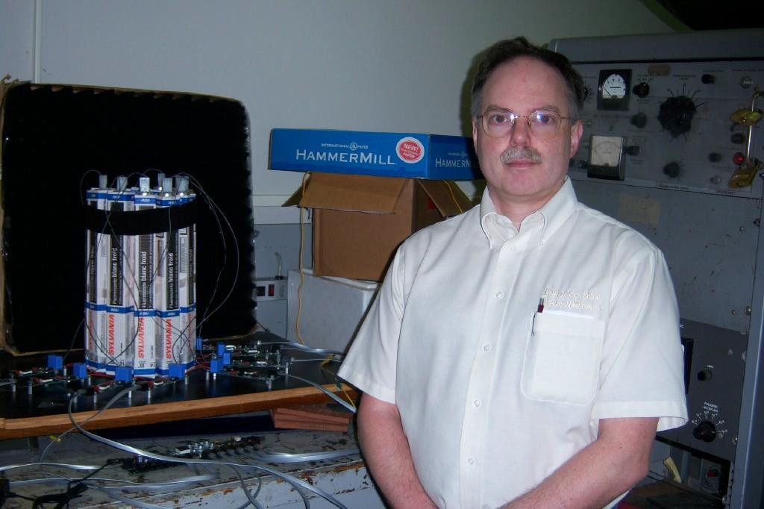
Our Smart Plasma Antenna Shown Below Can Do Steering but Can Also
be Re-designed to do Beam Focusing and Steering.
Play video of our smart plasma antenna on our website: www.haleakala-research.com

Slide 37
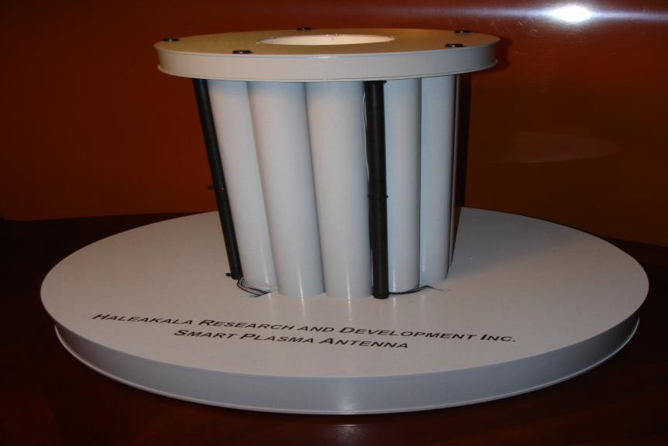
Our Ruggedized Version of Our
Smart Plasma Antenna

Slide 38
Antenna Range Increases by Decreasing the Beam Widths with Plasma Lens Focusing
One bank of tubes acts as a convergent plasma lens to
decrease the half power beam widthθ,₁
A perpendicular bank of tubes as a convergent plasma lens to decrease the half power beam width,
θ ₂
Directivity increases:
Directivity =
4π
θ₁θ₂
Antenna range increases:
⎛ NewDirectivity ⎞
1
2
NewRange = OldRange⎜ ⎟
OldDirectivity
⎝
⎠

Slide 39
Range Increases More When both Transmitting and Receiving Antennas use Plasma Lens Focusing
The beamwidths of both the transmitting and receiving
antennas is decreased by plasma lens focusing
– The directivities of both the transmitting and receiving antennas is improved by plasma lens focusing.
⎛ NewDirectivity
NewDirectivity
⎞
1
2
_{NewRange = OldRange⎜} TransmittingAntenna Re ceivingAntenna ⎟
⎜
⎝
OldDirectivity
OldDirectivity
⎟
⎠
TransmittingAntenna
Re ceivingAntenna

Slide 40
Conclusions
An electronically steerable and focusing bank of plasma tubes can be made by having plasma densities in the tubes below cutoff but with the plasma densities varying from tube to tube.
Electronic steering and focusing can be made in two dimensions by having two perpendicular banks of tubes.
  This can also steer and focus horizontal, vertical, circular, and elliptically polarized signals.
Plasma convergent lens focusing
  enables focusing of the electromagnetic waves
  decreases beamwidths
  increases directivity
  increases antenna range

