Slide 1

Answers to Common Questions
Dr. Theodore Anderson
CEO, Haleakala R&D, Inc.
www.ionizedgasantennas.com
Dr. Ted Anderson; Haleakala R&D; Proprietary
1

Slide 2
Questions
1. How will the plasma bias voltage be obtained for a battery operated military portable radio system? How many watts volts and amps from the battery? More data is needed.
Short answer: We were using a modular "brick" power supply rated for 6 Watts. This was enough to pulse-power our lower frequency (< 100 MHz) antennas. This of course was not optimized, but I think we would need a power > 2 Watts in any case.
One possible way to help is to briefly activate the plasma antenna every few seconds to look for a signal that it needs to receive. Also, newer
radios, transmit in short burst "packets" for encryption and to reduce the chance of being located. The plasma antenna could be turned on only when transmitting and actively receiving.
Dr. Ted Anderson; Haleakala R&D; Proprietary
2

Slide 3
2. The plasma antennas are seen as being strong enough for fixed applications and may stand up to vehicular.
Questions
Dr. Ted Anderson; Haleakala R&D; Proprietary
3

Slide 4
Questions
The power demand to maintain plasma is seen as difficult to impossible to allocate for battery operated portable systems. Please advise?
Obtaining, and using, high voltage is concerning in a military portable. Battery drain is a biggie. How will the plasma bias voltage be obtained for a battery operated portable radio system? How many watts volts and amps from the battery? More data is needed.
Dr. Ted Anderson; Haleakala R&D; Proprietary
4

Slide 5
Questions
How is the plasma frequency adjusted in a plasma antenna?
How is the RF kept out of the bias wires on the plasma tube tops?
Dr. Ted Anderson; Haleakala R&D; Proprietary
5

Slide 6
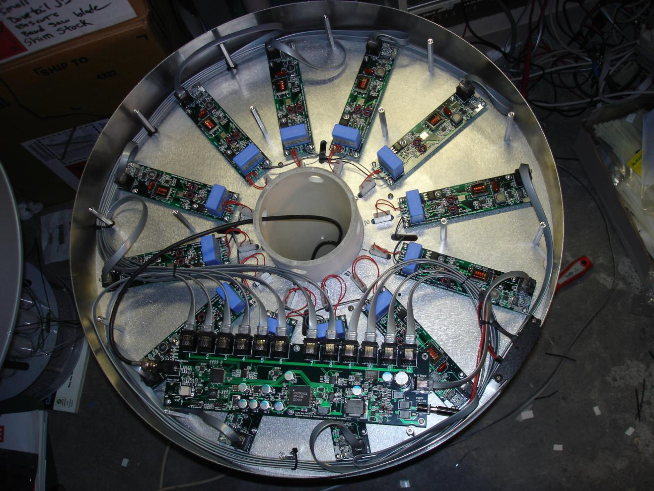
Wiring for Ruggedized Smart
Plasma Antenna
Dr. Ted Anderson; Haleakala R&D; Proprietary
6

Slide 7
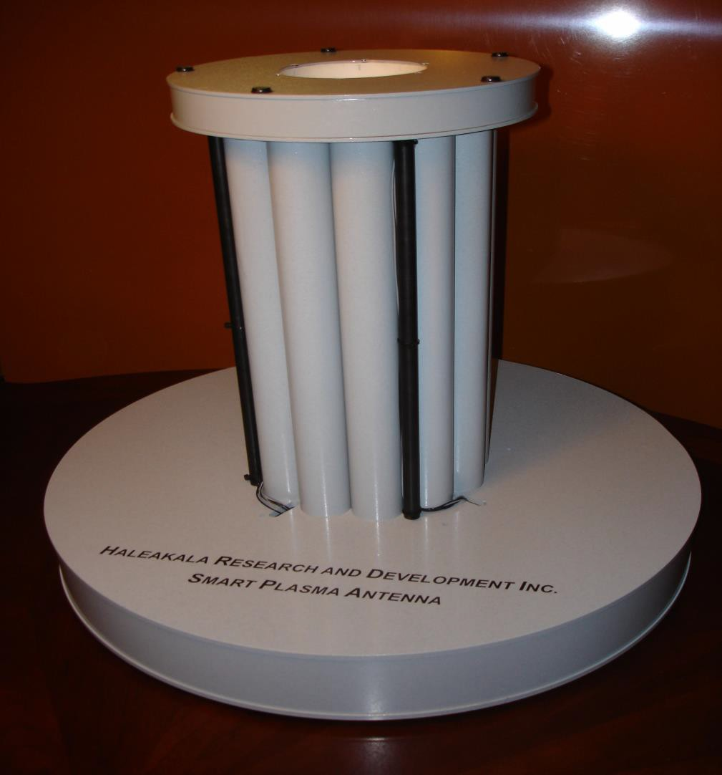
Ruggedized Smart Plasma
Antenna
Dr. Ted Anderson; Haleakala R&D; Proprietary
7

Slide 8
Pulsed Plasma Driver Circuit
Dr. Ted Anderson; Haleakala R&D; Proprietary

Slide 9
Pulsed Plasma Driver Circuit
Our plasma antennas are able to work at high frequencies (>40GHz) because of a concept invented by Igor Alexeff and Theodore Anderson that uses fast high- current pulses; instead of DC current.
The plasma initiates quickly in less than a microsecond, but when plasma ionizing current is turned off, the ions take about a millisecond to recombine with electrons.
Therefore plasma density stays high for almost a millisecond even though the ionizing current is no longer on.
If we use an even shorter pulse width, and therefore less power is required to run the antenna.
We developed a pulsed voltage doubler circuit, allowing us to use a lower voltage DC power supply for the input power to the pulsing circuit.
Dr. Ted Anderson; Haleakala R&D; Proprietary

Slide 10
Pulsed Plasma Driver Circuit
Modified Marx Generator
A Marx Generator is a pulsed voltage multiplier .
A series of capacitors is charged in parallel and then
discharged in series through spark gaps.
We present a two stage voltage doubler circuit.
We have built and tested a modified Marx Generator that replaces the first spark gap with an IGBT electronic switch.
Dr. Ted Anderson; Haleakala R&D; Proprietary
10

Slide 11
Pulsed Plasma Driver Circuit
Our new modified Marx Generator works even
better than expected.
Keeping the second spark gap in the circuit results in a faster rise time than in our previous pulsing circuits.
The voltage doubler allows the use of a 1000VDC power supply instead of a 2000VDC power supply.
Dr. Ted Anderson; Haleakala R&D; Proprietary

Slide 12
Pulsed Plasma Driver Circuit
The IGBT switch and pulsing driver circuit is shown in Fig 5. A CMOS timer IC is used to generate short 1 µs pulses with a repetition time of 750 µs.
An IXYS brand 2500 Volt IGBT is high voltage switch.
Our figure shows the new faster pulse current waveform compared to the pulse waveform used until recently.
The pulse from the Marx Generator circuit is about 1 µs in width compared to 5 µs from the previous pulser circuit.
Since pulse width is a factor of five shorter, then power consumption is a factor of five lower!
Dr. Ted Anderson; Haleakala R&D; Proprietary

Slide 13
Spark Gaps
Plasma Tube
Marx Generator Pulse Voltage Doubler
Electronic Switch
5K
5K
Spark Gap
1000 VDC
.022 MFD
5K
.022
MFD
Plasma Tube
1000 Volt DC to D2r0. T0ed0AVnodeltrsoPnu; lHsaeleCakiarlcauRi&tDU; PsrionpgrieMtaroydified Marx Generator

Slide 14
Electronic Switch
5K
5K
1000 VDC
.022 MFD
.022
5K
MFD
Plasma Tube
1000 Volt DC to 2000 Volt Pulse Circuit Using Modified Marx Generator With No Spark Gap
Dr. Ted Anderson; Haleakala R&D; Proprietary

Slide 15
Modified and More Robust Pulsing Circuit
Dr. Ted Anderson;
15

Slide 16
Modified, More Robust Pulsing Circuit
We have been driving our plasma antenna tube with fast, high-current pulses to allow operation at higher frequencies than is possible with CW current..
Our pulsing circuit had required that the both electrodes of the plasma tube operate at high voltage; with the positive electrode at constant maximum DC voltage (2-3 KV).
We have modified the circuit to allow the negative electrode to remain grounded while a positive 1 μs pulse is applied to the anode electrode. This change offers several advantages:
  Improved electrical safety because one electrode remains grounded and the
other electrode is supplied with short pulses.
  Less capacitive loss in the current leads allowing the use of faster pulses; since one electrode is grounded and can be attached to a ground plane.
  Eliminating the need for a negative lead wire means less high voltage wiring.
  Lower EMI caused by high current pulses in wiring.
Dr. Ted Anderson; Haleakala R&D; Proprietary
16

Slide 17
Modified, More Robust Pulsing Circuit
Grounding one side of the plasma tube requires that the high voltage switcher (IGBT) be able to float up and down in voltage with the tube’s anode.
  To do this we have electrically isolated the switcher by using a battery to power the
electronics and by potting the IGBT and electronics in epoxy.
  Figure is a schematic diagram of the new switching arrangement. Figure shows our first prototype with steel-filled epoxy; not the best choice of epoxy but one that is working quite well so far.
Potting the circuit is advantageous for airplane and aerospace applications, providing mechanical ruggedness as well as electrical isolation.
Epoxy has much higher thermal conductivity than air, but not as good as a metal heat
sink.
  The steel filled epoxy has about a factor of ten higher thermal conductivity than air.
  Highly thermally conductive epoxies can have a factor of 100 higher conductivity than air.
  Potting in epoxy in our case allowed operation without an additional metal heat sink, saving
space and eliminating the need for electrical isolation between the IGBT and a metal heat sink.
Dr. Ted Anderson; Haleakala R&D; Proprietary
17

Slide 18
Modified, More Robust Pulsing Circuit
We tested the ruggedness of our epoxy-potted circuit by dropping it on a concrete
floor from a height of 6 ft. without damage to the circuit.
We ran the circuit shown in Figure (with no additional heat sink) with peak
current of 20 A and a pulse period of 100 μs.
  After ½ hour of operation, the epoxy and IGBT were warm to the touch with no indication of over-heating
Dr. Ted Anderson; Haleakala R&D; Proprietary
18

Slide 19
Power Supply
Battery
Pulsing Circuit
IGBT
Epoxy Potting
Modified pulse power supply with grounded plasma tube and floating high voltage switch.
Plasma Tube
Dr. Ted Anderson; Haleakala R&D; Proprietary
301
9

Slide 20
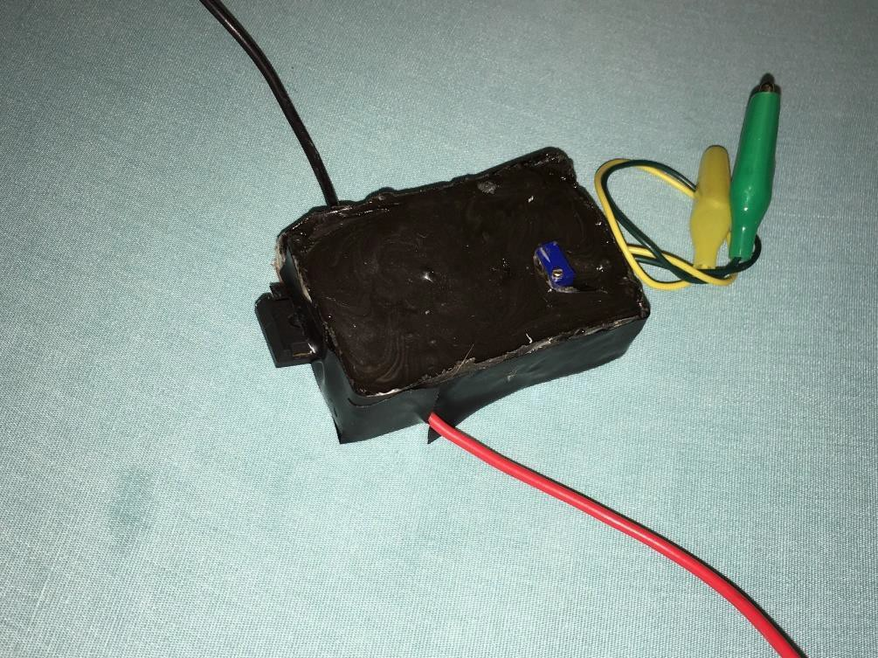
Modified, More Robust Pulsing Circuit
High Voltage switching circuit potted in epoxy. The IGBT switching transistor is partially extending from the left . High voltage leads are above and below; and the low voltage power supply leads are on the right. A blue potentioneter used to vary pulse period is on top.
Dr. Ted Anderson; Haleakala R&D; Proprietary
20

Slide 21
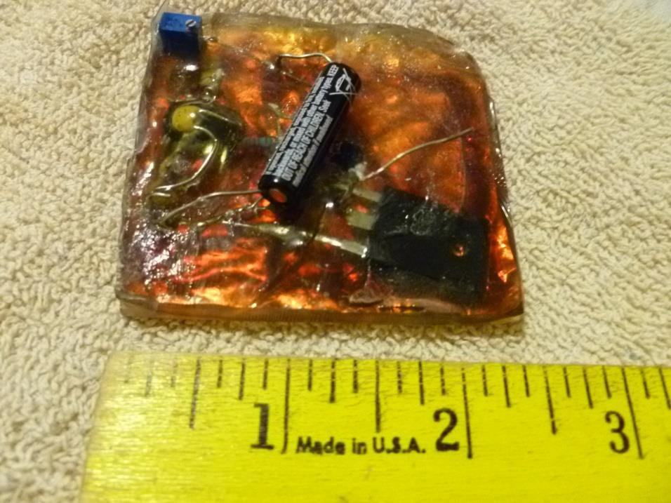
Modified, More Robust Pulsing Circuit
Figure 2 Epoxy encapsulated high voltage switching module. 12V battery is the black
cylinder in the center.
Dr. Ted Anderson; Haleakala R&D; Proprietary
21

Slide 22
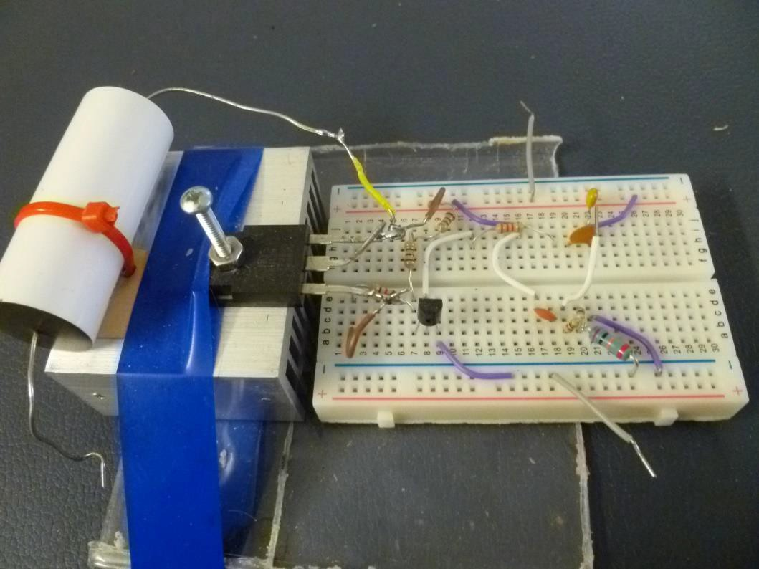
Modified, More Robust Pulsing Circuit
Prototype of faster solid state pulsing circuit. High voltage discharge capacitor and heat sink are on the left. The black semicondoctor attached to the heat sink is the IGBT switching transistor.
Dr. Ted Anderson; Haleakala R&D; Proprietary
22

Slide 23
Custom Made Tubes and Ruggedization
Dr. Ted Anderson; Haleakala R&D; Proprietary

Slide 24
Questions
Many of the antennas for field use have to be stowed. No one can visualize how the plasma antennas can be folded up when not in use for portable applications. How can this be accomplished?
  What other material, beside glass, is suitable or process friendly for plasma tube for rugged applications?
  What is the thinnest tube that’s realized so far? Any other shapes besides straight tubes?
Dr. Ted Anderson; Haleakala R&D; Proprietary

Slide 25
Custom Made Tubes and Ruggedization
American Scientific Glassblowers Society
Taken from website:
http://asgs-glass.org/mo/index.php/about-the-society
“Founded in 1952 and incorporated in 1954, the American Scientific Glassblowers Society began as a professional, not-for- profit organization of scientific glassblowers and suppliers associated with the field. The objectives of the Society are to further the education of its membership through the gathering, promotion, and dissemination of technical and scientific information concerning all aspects of scientific glassblowing.
Today the ASGS comprises approximately 650 members and a variety of affiliate members. Regional Sections offer local members an opportunity to meet with other glassblowers in their area.”
Dr. Ted Anderson; Haleakala R&D; Proprietary

Slide 26
Custom Made Tubes and Ruggedization
SynFoam
Taken from website:
http://synfoam.com/
“SynFoam syntactic foam consists of hydrospace quality hollow glass microspheres dispersed in a high strength plastic matrix.
Upon curing, the resultant syntactic foam composite provides
high strength and low density with very low moisture absorption.
Synfoam products are used in the marine and oceanographc industry for use as floats, buoys and as a void filler in submarines, capable of withstanding depths below 7,000 feet.
•
Dr. Ted Anderson; Haleakala R&D; Proprietary

Slide 27
Custom Made Tubes and Ruggedization
SynFoam buoyancy modules are being used for Remotely Operated Vehicles (ROVs) and Autonomous Underwater Vehicles (AUVs), deep water moorings, torpedo target and sonar arrays, and scientific instrument applications.
Synfoam products are also used in aerospace industries as cores for sandwich structures and as a repair and replacement for existing honeycomb structures.
SynFoam products can also be tailored to meet acoustic characteristics such as transparency, absorption, reflection, and refraction in underwater applications including transducer isolators and decouplers in addition to providing buoyancy related properties.”
Dr. Ted Anderson; Haleakala R&D; Proprietary

Slide 28
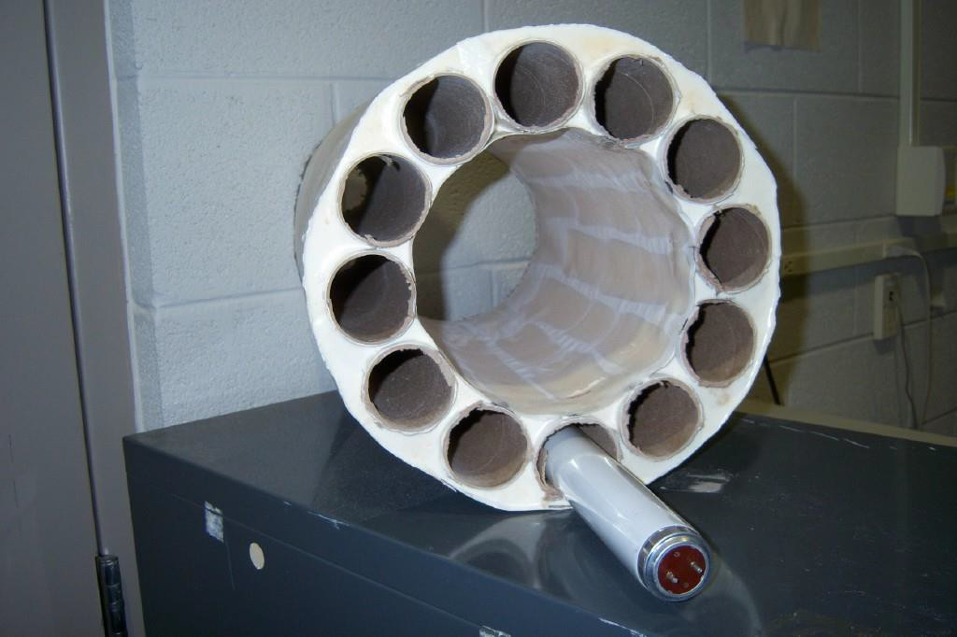
Our SynFoam Hosuing for the Plasma Tubes.
House the plasma tubes in strong and lightweight synthetic foam called Synfoam which can be molded into any shape we want. UDC SynFoam is a high performance syntactic foam combining high strength and low density with very low moisture absorption. SynFoam's syntactic foam products feature a density of less than 20 pcf and a compressive strength greater than 2000 psi. The index of diffraction of the Synfoam is nearly one so it is invisible to rf signals. See website: http://www.udccorp.com/products/synfoamsyntacticfoam.html.
Synfoam Housing for our Plasma Tubes. We have cushioning foam to put around the tubes in this encapsulation. We can mold Synfoam into any shape we want. We will make custom made rugged tubes as well. Plasma can be put inside the cylindrical chambers without the tubes.
Dr. Ted Anderson; Haleakala R&D; Proprietary
28

Slide 29
Custom made plasma tubes and ruggedization.
We have begun testing some materials to determine suitability for use as the envelope for plasma antenna tubes.
Glass has low gas permeability and can maimtain low vapor pressure, but a more rugged material would be preferred.
Ceramic has been used in electronic vacuum tubes for decades and is much less prone to breakage than glass.
There are also newer Gorilla Glass Diamond Glass materials that are preferable to ordinary
glass.
We have our vacuum pumping station in full operation.
We have tested the vacuum maintaining capabilities of polycarbonate and Teflon.
Teflon would be an ideal material for its high electrical resistivity; but we have found
that it may be too permeable to maintain a vacuum.
Our vacuum system could only pump down to a pressure of about 1 mm Hg Teflon.
Polycarbonate is much better in that we were able to pump to about 50 microns Hg pressure.
Dr. Ted Anderson; Haleakala R&D; Proprietary
29

Slide 30
American Scientific Glassblowers Society
We have begun discussions with the American Scientific Glassblowers Society for making rugged custom made tubes. We believe by encapsulating the custom made tubes in SynFoam should be very rugged.
•Taken from website American Scientific Glassblowers Society: http://asgs-glass.org/mo/index.php/about-the-society
“Founded in 1952 and incorporated in 1954, the American Scientific Glassblowers Society began as a professional, not-for-profit organization of scientific glassblowers and suppliers associated with the field. The objectives of the Society are to further the education of its membership through the gathering, promotion, and dissemination of technical and scientific information concerning all aspects of scientific glassblowing.
Today the ASGS comprises approximately 650 members and a variety of affiliate members. Regional Sections offer local members an opportunity to meet with other glassblowers in their area.”
Dr. Ted Anderson; Haleakala R&D; Proprietary
30

Slide 31
Custom made plasma tubes and ruggedization.
We had a custom Pyrex plasma tube made.
This tube will have a diameter of 3 inches and will have a pump-out tube with stopcock that we can use to do our own pumping, back gas fill and bake-out.
Dr. Ted Anderson; Haleakala R&D; Proprietary
31

Slide 32
Neon sign
Glass transition X2
electrode X2
(~5/8 dia)
Glass tube (~ 3 in dia)
Material: Glass – Type not critical.
Wall as thin as practical.
Gas fill: Argon. Pressure ~ 1 Torr Exact pressure to be specified later Electrodes: Standard neon lamp electrodes ~ 5/8 – ¾ dia)
Dimensions are not critical. Eg if 3 in.
is not a standard diameter tube then
2.75 or 3.25 is acceptable.
~ 8 in.
son;
Custom Plasma Antenna Tube
Dr. Ted Ander
Haleakala R&D; Proprietary
32

Slide 33
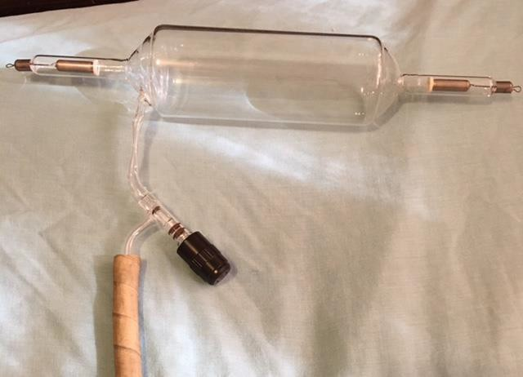
Custom made plasma tubes and ruggedization.
Custom Plasma Antenna tube with pump-out and stopcock. Diameter is 3 inch and main body length is 7 inch. 80 mA neon sign electrodes are used.
Dr. Ted Anderson; Haleakala R&D; Proprietary
403
3

Slide 34
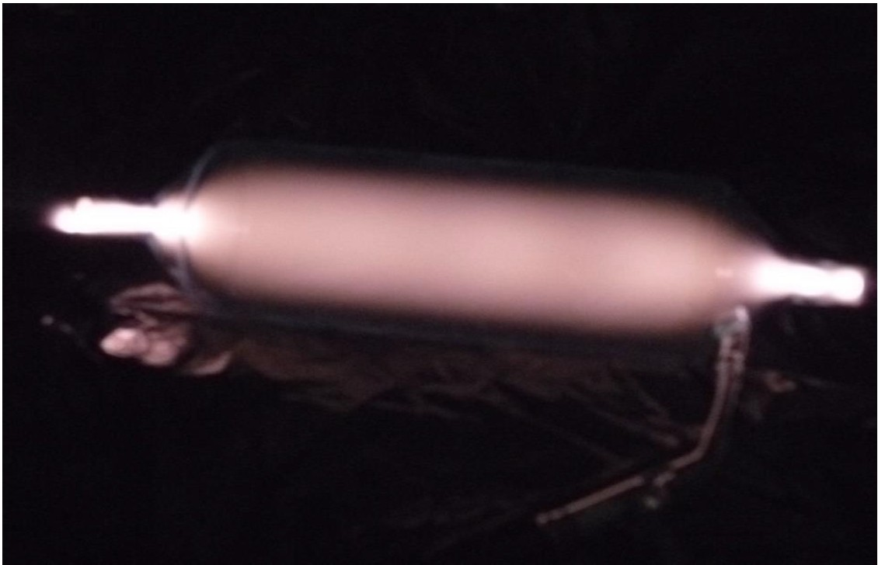
Custom made plasma tubes and ruggedization.
Dr. Ted Anderson; Haleakala R&D; Proprietary
41
4

Slide 35
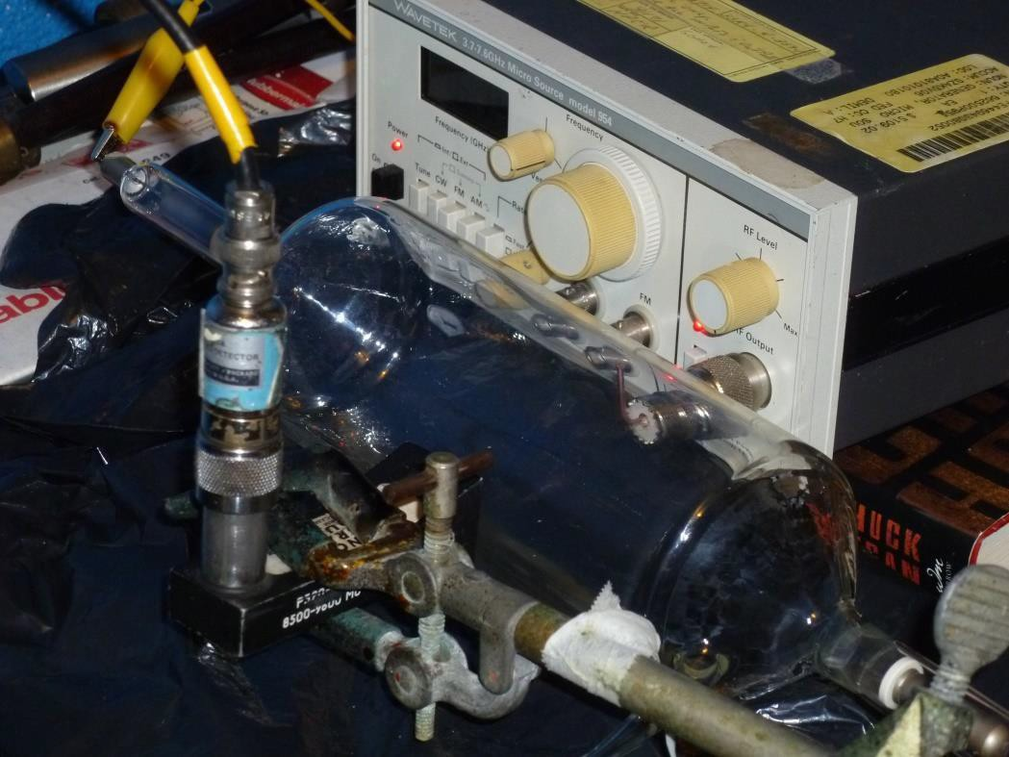
Custom made plasma tubes and ruggedization.
Test of RF transmission (6.75 GHz) through the new custom Plasma Antenna. The signal generator and ~1/4 wave transmitting antenna is on the right of the tube and on the left is a waveguide receiving horn with HP
Crystal Detector.
Dr. Ted Anderson; Haleakala R&D; Proprietary
35

Slide 36
Custom Plasma Tube Pulse Characteristics
This photo of our custom made tube shows a DC plasma with a discharge current of 100 mA and backfill argon 300 microns pressure.
Interesting striations are seen on the left side of the tube (cathode side) and “sausage” pinching is visible near both electrodes. The striations and pinching are not visible when plasma current is pulsed.
We are finding that our custom tube has different operating characteristics compared
to the mercury filled fluorescent lamps we typically use.
Our figure typical current-voltage pulse waveforms that we are seeing with the custom tube.
Compared to the fluorescent lamp, current rises slowly after application of voltage to the tube (~2.5 μs), and the current also falls slower (~2.0 πs).
The Figure shows a peak voltage of 5000 V and a peak current of ~5.5 A.
Dr. Ted Anderson; Haleakala R&D; Proprietary
36

Slide 37
Custom made plasma tubes and ruggedization.
Optimum background gas pressure (for maximum signal attenuation) was found to
be about 200-300 microns.
Interestingly, the typical fluorescent lamp gas pressure of around 1000 microns had
almost no signal attenuation.
The current pulse is fast (~ 1 μs, top trace) but the 6.75 GHz attenuation is slow in
developing (~20 μs, lower trace).
Also as seen that the plasma density appears to decay faster than in a fluorescent
lamp; indicated by the microwave attenuation lasting only about 40 μs.
Fluorescent lamps have a much longer plasma density decay of several hundred μs.
Pulsed current required to attenuate a given frequency is about a factor of four
higher than required in a 1.5 in. diameter fluorescent lamp.
This is because the cross sectional area of our 3 in custom tube is 4 times larger than that of the 1.5 in. dia. lamp. Therefore to generate a plasma of a given density requires a current four times higher in our new custom tube.
Dr. Ted Anderson; Haleakala R&D; Proprietary
37

Slide 38
Custom made plasma tubes and ruggedization
Use Xenon gas for better constant density.
Xenon has Atomic number 54; Atomic weight 131 Compare to Argon with Atomic number 18 and
Atomic weight of 40.
Compare to Mercury with atomic number of 80 and Atomic weight of 200.
Dr. Ted Anderson; Haleakala R&D; Proprietary
38

Slide 39
SynFoam
We have already used SynFoam to encapsulate plasma tubes with success.
Taken from SynFoam website:
http://synfoam.com/
“SynFoam syntactic foam consists of hydrospace quality hollow glass microspheres dispersed in a high strength plastic matrix.
Upon curing, the resultant syntactic foam composite provides high strength and low density with very low moisture absorption.
Synfoam products are used in the marine and oceanographc industry for use as floats, buoys and as a void filler in submarines, capable of withstanding depths below 7,000 feet.
Dr. Ted Anderson; Haleakala R&D; Proprietary
39

Slide 40
Custom made plasma tubes and ruggedization.
Ruggedization Progress.
  We have procured Teflon and Ultra-High Molecular Weight (UHMW) polyethylene tubing to test for possible use as a plasma tube.
  Both types of tubing have:
» Flexibility
» Non-conductivity
  Teflon tubing sheathed by Ultra-High Molecular Weight (UHMW) polyethylene tubing is fairly rugged. We will make sure it is as rugged as possible.
Test the tubing to house plasma and become plasma antennas
Dr. Ted Anderson; Haleakala R&D; Proprietary
49

Slide 41
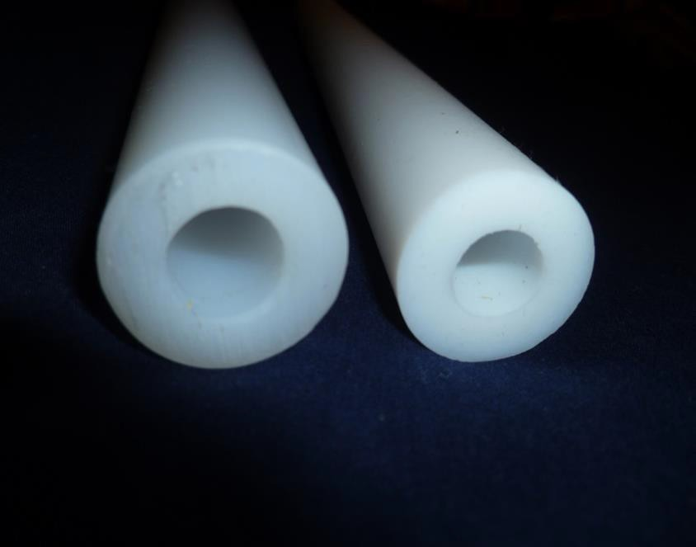
Custom made plasma tubes and ruggedization.
Figure 4. PTFE Teflon (right) and UHMW polyethelyne (left)
Dr. Ted Anderson; Haleakala R&D; Proprietary
504
1

Slide 42
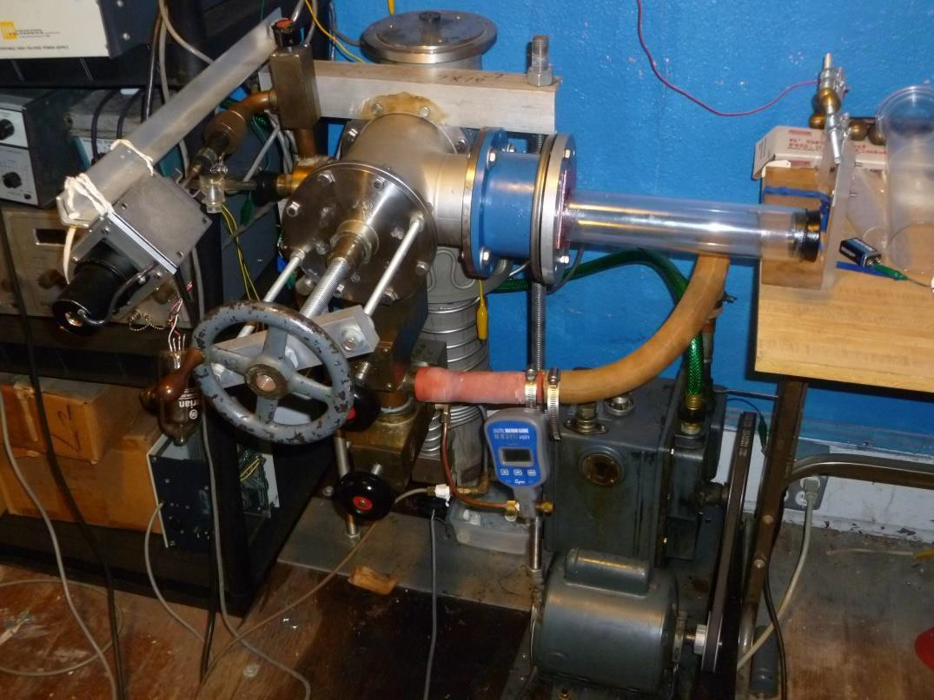
Custom made plasma tubes and ruggedization.
Vacuum pumping system testing a
polycarbonate tube.
Dr. Ted Anderson; Haleakala R&D; Proprietary
42

Slide 43
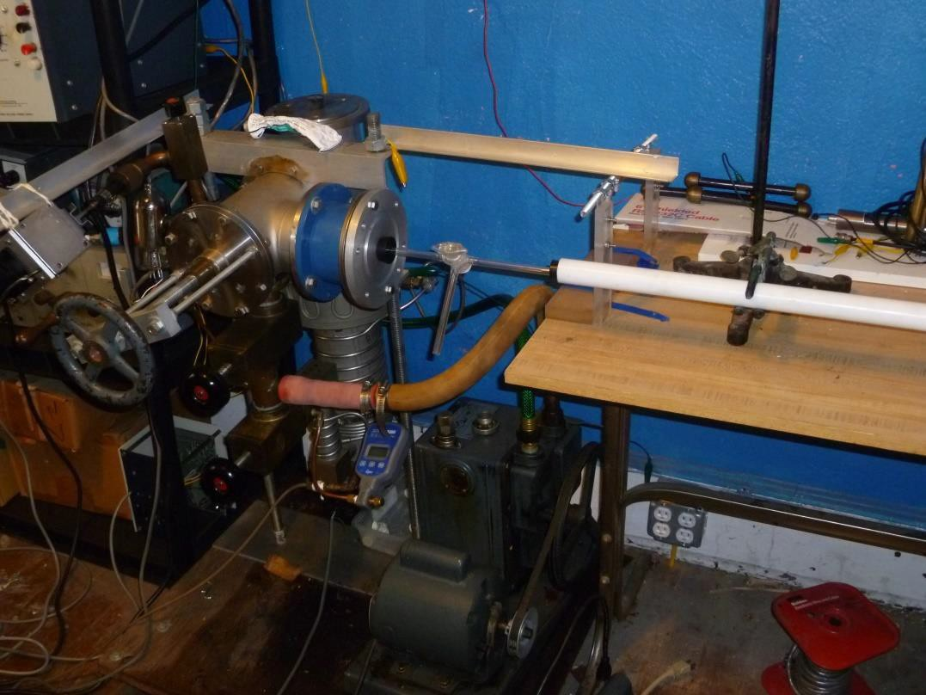
Custom made plasma tubes and ruggedization.
Teflon tube under test for ability to maintain vacuum.
Dr. Ted Anderson; Haleakala R&D; Proprietary
43

Slide 44
Custom made plasma tubes and ruggedization.
We are progressing toward a more robust, safer pulsing circuit with lower EMI interference.
  Epoxy potting of the circuit and a rearrangement of the circuit has clearly made our high voltage pulser more practical and easier to manufacture.
  Our new custom plasma tube electrically works well; starting easily and working
smoothly with current pulsing.
    Its RF interaction characteristics however are different from those seen in fluorescent lamps.
    The most surprising difference is that the custom tube plasma density appears to decay faster than in a fluorescent lamp. We will study this further to find out why there is a difference.
Dr. Ted Anderson; Haleakala R&D; Proprietary
44

Slide 45
Custom made plasma tubes and ruggedization.
We used neon sign electrodes in the custom tube because they handle higher current and voltage discharge without sputtering of the electrodes with the resulting deposit of metal inside the glass envelope.
The oxide filaments may allow faster plasma build-up compared to neon electrodes; because high current spots on the filament may heat the oxide causing faster electron emission from the cathode.
Another difference we see with the custom tube (As reported last month) is that the plasma decays more quickly after a fast (µs) current pulse.
Another difference we see with the custom tube is that the plasma decays more quickly after a fast (µs) current pulse.
Decay time with the custom tube is <100 µs while plasma decay time with the fluorescent tube is >750 µs.
Dr. Ted Anderson; Haleakala R&D; Proprietary
45

Slide 46
Custom made plasma tubes and ruggedization.
We have made progress in the following areas:
Evacuating, Filling and Baking Custom Plasma Tubes
We have continued testing our new custom plasma antenna tubes.
  It is important to be able to fill the tubes with gas at proper pressure and then seal them off for continued testing away from the vacuum system.
The following procedure was used:
Connect to vacuum pump and evacuate to the lowest pressure obtainable with mechanical and diffusion pumps. (~5x10⁻⁵ Torr).
Wrap tube with laboratory heating tape and bake for 8 hours.
Back-fill tube with Argon to 200 micron and seal-off tube with stopcock.
Dr. Ted Anderson; Haleakala R&D; Proprietary
46

Slide 47
Custom made plasma tubes and ruggedization.
2. Using Custom Plasma Tubes in Pulsed Current Mode
Our testing of the custom plasma tubes has shown a plasma density decay time after the current pulse of 50 µs.
The Argon in our tube has an atomic number of 18 which causes a shorter decay time of the plasma.
3. Compact High Voltage Switching Circuit
Work on small epoxy potted switching circuits is continuing. We are now testing the use of the IGBT switching transistor and pulsing circuit as an isolated battery powered module; allowing us to place the high voltage switching capability anywhere in the circuit without concern for grounding issues.
Dr. Ted Anderson; Haleakala R&D; Proprietary
47

Slide 48
Direct Co-site Interference
Reduction Experiments
Dr. Ted Anderson; Haleakala R&D; Proprietary
48

Slide 49
Questions
1. Some instantaneous cosite frequency separation needs are less than an octave. What is the frequency slope of plasma over frequency? How much attenuation does an antenna at 2F see looking through the antenna at 1F, where F is a UHF frequency.
Here are an article with a couple of photos showing exactly what people are asking about. The antenna's length is tuned for 160 MHz. At 320 MHz, the transmitted/received signal is at least 20 dB lower. At 500 MHz the isolation is better (>30 dB)
http://www.antennasonline.com/main/articles/recent-progress- on-plasma-antennas/
Dr. Ted Anderson; Haleakala R&D; Proprietary

Slide 50
. The electric field barrier penetration as a function of the ratio between the field frequency
and the plasma frequency. (The plasma cylinder is infinitely-long, and has radius R=1 cm).
Dr. Ted Anderson; Haleakala R&D; Proprietary

Slide 51
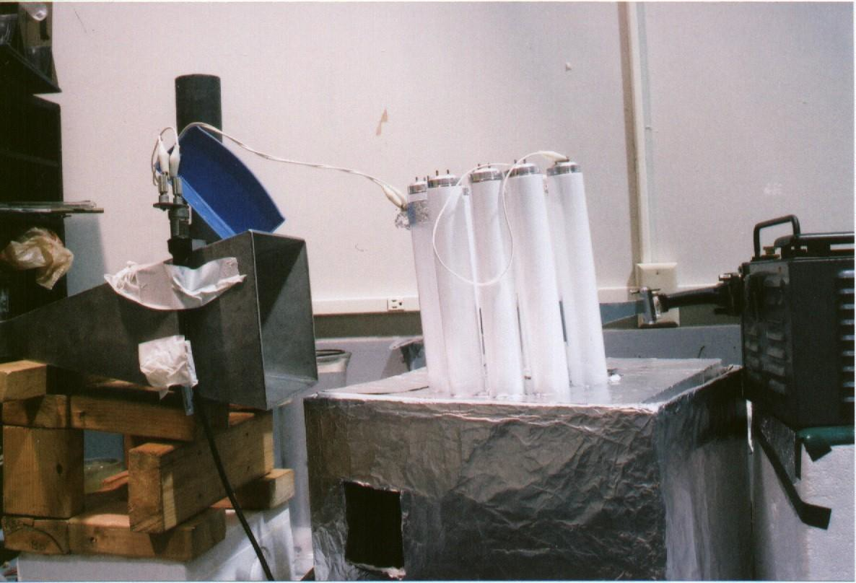
Nested Plasma Antennas
Dr. Ted Anderson; Haleakala R&D; Proprietary
51

Slide 52
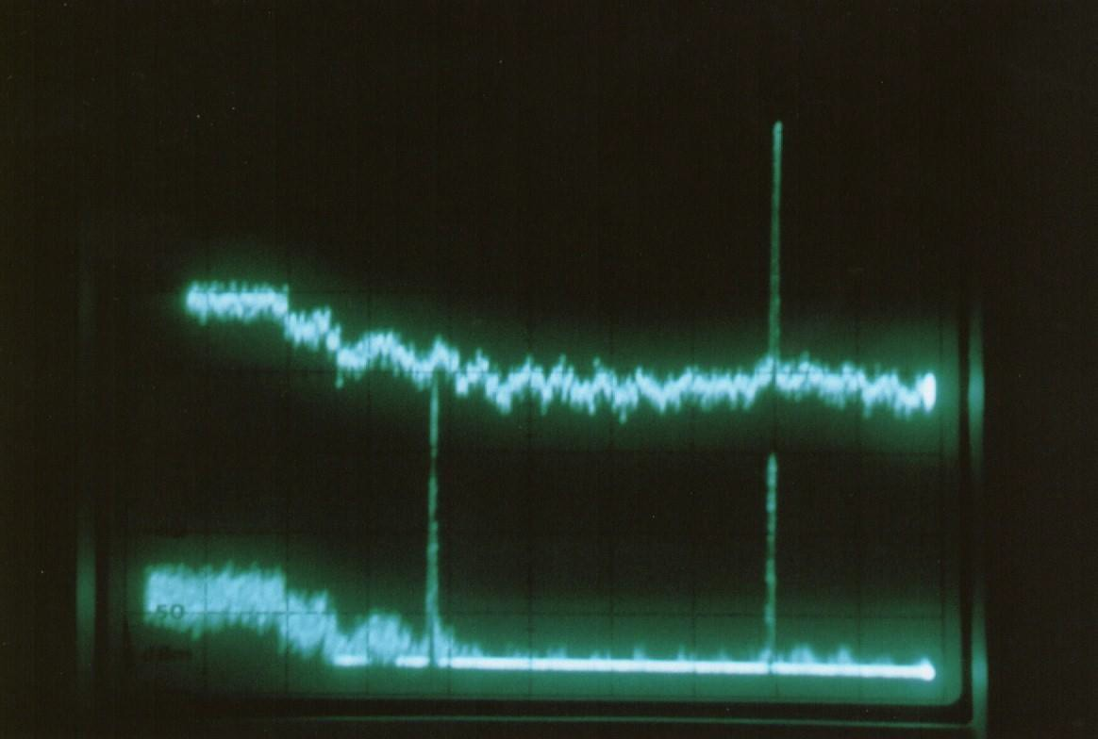
Nested Plasma Antenna
Dr. Ted Anderson; Haleakala R&D; Proprietary
52

Slide 53
Nested Plasma Antennas
Higher frequency plasma antennas can be nested inside lower frequency plasma antennas
  The high frequency plasma antennas will send signals that can propagate through the lower frequency plasma antennas
  Bandwidths and power add of the various nested layers.
  Large bandwidths, narrow bandwidths, and multiband widths are possible.
  Nesting antennas is not possible with metal antennas
  Stacked plasma antenna arrays can be done with the higher frequency arrays sending signals through the lower frequency arrays.
The frequencies used were 4 GHz and 8 GHz.
The higher frequency was emitted from a microwave horn. This horn was placed inside a half-circle of plasma tubes (fluorescent lamps).
These tubes are energized by high – current pulses of 2 microsecond duration repeated every millisecond, which forms a dense steady – state plasma.
The lower – frequency signal is applied to the two tubes directly in front of the high – frequency microwave horn by capacitive couplers.
This results in forming a plasma loop antenna in front of the higher – frequency microwave emitting horn when the plasma tubes are energized.
Both low and high frequencies are received by a broad – band microwave horn, amplified by a traveling wave tube amplifier, and displayed on a panoramic receiver.
Dr. Ted Anderson; Haleakala R&D; Proprietary
53

Slide 54
Nested Plasma Antennas
The experimental results are shown in the above
photo.
When the plasma antenna is not energized, the 8 GHz signal appears.
However, the 4 GHz signal is not visible, even
though the 4 GHz transmitter is operating.
When the plasma antenna is energized, both the 8
GHz and the 4GHz signals are received.
In this case, the 8 GHz signal is penetrating the plasma antenna operating at 4 GHz.
Note that the 8 GHz signal is not appreciably attenuated by the operating 4 GHz plasma antenna.
Dr. Ted Anderson; Haleakala R&D; Proprietary
54

Slide 55
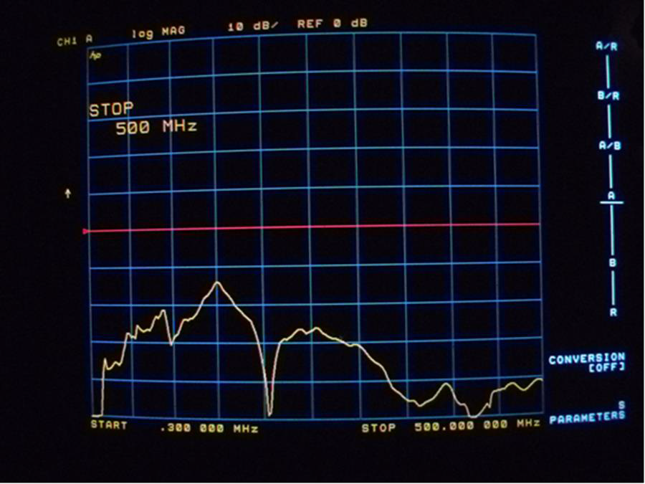
Transfer curve for the following conditions.
Transmitter antenna is a 19 inch vertical metal monopole antenna.
Receiver antenna is a 46 inch vertical metal monopole antenna.
Distance between transmitter and receiver rods is 10 inches.
Span of 0.3 MHz to 500 MHz.
10 dBm/div.
Dr. Ted Anderson; Haleakala R&D; Proprietary
55

Slide 56
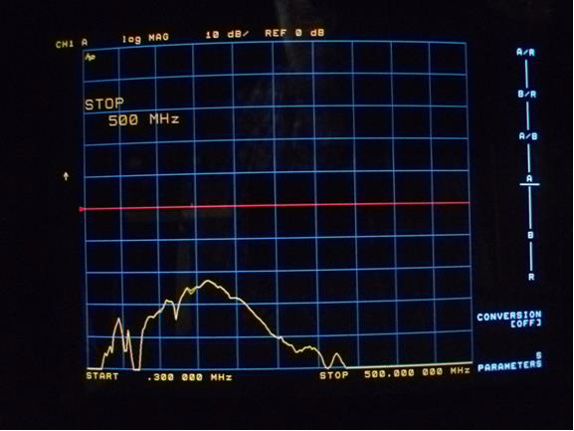
Transfer curve for the following conditions. Note the reduction in received signal above 300 MHz, compared with the metal antenna receiver.
Transmitter antenna is a 19 inch vertical metal monopole antenna.
Receiver antenna is a 46 inch vertical plasma monopole antenna with 60 mA DC drive current.
Distance between transmitter and receiver antennas is 10 inches.
Span of 0.3 MHz to 500 MHz.
10 dBm/div.
Dr. Ted Anderson; Haleakala R&D; Proprietary
56

Slide 57
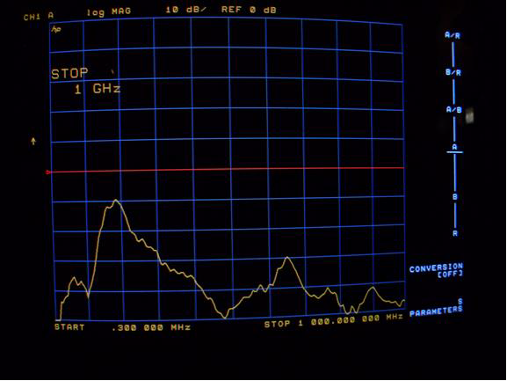
Transfer curve for the following conditions.
Transmitter antenna is an 17 inch vertical metal monopole antenna.
Receiver antenna is a 19 inch vertical metal monopole antenna.
Distance between transmitter and receiver rods is 10 inches.
Span of 0.3 MHz to 1000 MHz.
10 dBm/div.
Dr. Ted Anderson; Haleakala R&D; Proprietary
57

Slide 58
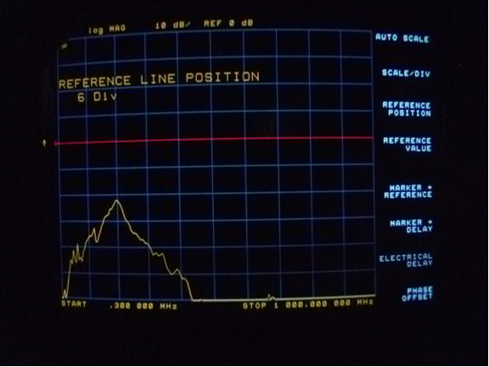
Transfer curve for the following conditions. Note the reduction in received signal
above 400 MHz, compared with the metal antenna receiving antenna.
Transmitter antenna is a 17 inch vertical metal monopole antenna.
Receiver antenna is a 19 inch vertical plasma monopole antenna with 150 mA DC drive current.
Distance between transmitter and receiver antennas is 10 inches.
Span of 0.3 MHz to 1000 MHz.
10 dBm/div.
Dr. Ted Anderson; Haleakala R&D; Proprietary
58

Slide 59
Improvements on Original Smart
Plasma Antenna
Our initial work concentrated on eliminating issues that have caused our Smart Plasma Antenna to have less than optimal performance. The basic design and concept have not been changed.
The plasma density has been increased by an order of magnitude by having a much higher peak current inside the tube. Average power dissipation remains low and there is very little heat generated.
A small gap (~0.1 in.) between each tube has been closed by placing adjacent tubes in direct contact with each other.
A new prototype was built using nine fluorescent tubes
placed in a circle.
A Zigbee 2.45 GHz transmitter with a ½ wave dipole is placed inside the circle of plasma tubes.
Dr. Ted Anderson; Haleakala R&D; Proprietary

Slide 60
Improvements on Original Smart
Plasma Antenna
Another ½ wave dipole (for receiving) is placed ~ 3 ft from the side of the antenna and connected to a B&K Precision 3 GHz spectrum analyzer.
Our experiments consisted of a smart plasma antenna transmitting to a receiving dipole connected to a spectrum analyzer.
Higher pulse current was achieved by pulsing with a higher peak voltage (3000 V) and higher peak current 20 A compared to our original Smart Antenna. This original Smart Antenna has a peak current of 1 A and peak voltage of 800 V.
Dr. Ted Anderson; Haleakala R&D; Proprietary

Slide 61
Improvements on Original Smart
Plasma Antenna
Replaced Zigbee transmitter with video transmitter
for higher power and narrower bandwitdth.
The transmitter in the center of the smart antenna was a Zigbee 2.4 GHz with attached ½ wave dipole.
This Zigbee transmitter is not the best device for
our application:
  It has low output power (for short range communication) and frequency-hops over a 2 MHz band; similar to WiFi devices. The low power and frequency shifting from the Zigbee transmitter limits our ability to accurately measure received power at the spectrum analyzer.
Dr. Ted Anderson; Haleakala R&D; Proprietary

Slide 62
Improvements on Original Smart
Plasma Antenna
We used a higher power transmitter for video
applications with a higher power of about 700 mW.
  It is compact, battery operated and will fit easily into the center of the smart plasma antenna. This change allowed us to have better measurements for testing the radiation pattern.
The dipole at the center of the array of plasma tubes was attached to an RF connector, enabling the antenna to be connected to a signal generator or spectrum analyzer.
Therefore the antenna can be used as either a transmitter or receiver. Currently a 2.4 GHz transmitter is mounted inside the antenna along with the dipole.
Dr. Ted Anderson; Haleakala R&D; Proprietary

Slide 63
Improvements on Original Smart
Plasma Antenna
In the next slide we show the results of these
improvements.
However, the radius is not optimized.
There is leakage along the axis of the smart plasma antenna.
There is leakage where the tubes touch since there
is no plasma at these points.
Dr. Ted Anderson; Haleakala R&D; Proprietary

Slide 64
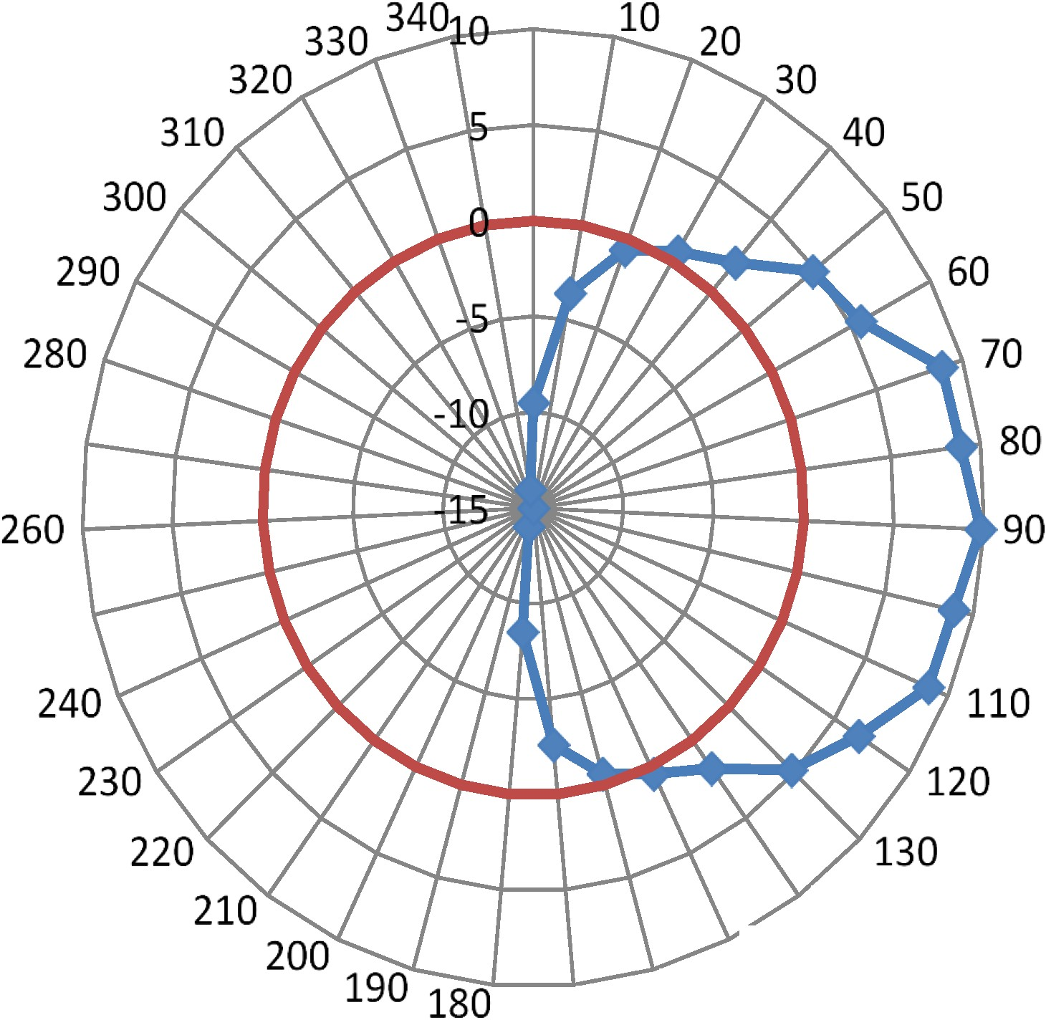
0
270
Series 1
250
100
-Series 2
140
150
170 160
Radiation Pattern {2.1GHz). Unity gain is shown in red.
Gain 9.5 dB; f = 2.1 GHz; Optimum frequency was found experimentally by tuning the signal generator. Signal power tv 10 mW from signal generator.
Dr. Ted Anderson; Haleakala R&D; Proprietary
64

Slide 65
Improvements on Original Smart Plasma Antenna
Conclusions
We improved the results for by closing the gaps between the tubes and increasing the plasma density.
As a result, the gain improved but by doing this we had to decrease the
radius of the smart plasma antenna so that was no longer optimized.
The only way to optimize all the parameters simultaneously is to use custom made plasma tubes for this purpose.
Further optimizing can be done by using annular rings of plasma rather than tubes so that the plasma density in the cylindrical annular ring is uniform.
Where the tubes touch, the plasma density and thickness is negligible and increases at the axes of the tubes.
We redesigned the smart plasma antenna and developing new
electronics and controls to increase the plasma density.
Dr. Ted Anderson; Haleakala R&D; Proprietary

Slide 66
Improvements on Original Smart Plasma Antenna
Conclusions continued
The pulsed DC power supplies are being packaged more ruggedly and mounted at the base of the plasma tubes. Shorter wire connections between the power supplies and tubes are resulting in less stray capacitance and faster rise and fall times.
Dr. Ted Anderson; Haleakala R&D; Proprietary

Slide 67
Alternative Smart Plasma Design
We also determined that we could make the smart plasma much smaller by building a 4 beam smart plasma antenna with 4 plasma windows at right angles and creating a single or multibeam plasma antenna by switching the plasma windows on or off.
This also allows us to use horizontal tubes with vertical tubes superimposed on the horizontal tubes. This would enable transmission and reception of vertical, horizontal, and circular polarizations.
Dr. Ted Anderson; Haleakala R&D; Proprietary

Slide 68
Gain.
Dr. Ted Anderson; Haleakala R&D; Proprietary
6
8

Slide 69
Gain
We tested a 2.4 GHz co-linear dipole antenna (TP-Link) that has a gain of 8 dBi.
We confirmed this advertised gain by testing the TP-Link antenna using a standard
2.1 dBi dipole antenna.
We have replaced the metal antenna in the center of our smart antenna with the high gain col-linear dipole; and then performed gain and radiation pattern measurements for the smart antenna.
Results are encouraging with a measured gain of 13 dBi and a front to back radiation ratio of 20 dB.
Plasma lens focusing can increase the gain from 3 to 6 dBi for a total of 16dBi to 19dBi just short of our goal of getting 20 dBi .
We still have a mismatch in the resonance of the TP Link dipole antenna and the
smart plasma antenna. The gain will increase when this match is achieved.
We have very good gain with a very compact steerable antenna.
Dr. Ted
6
Anderson;
9

Slide 70
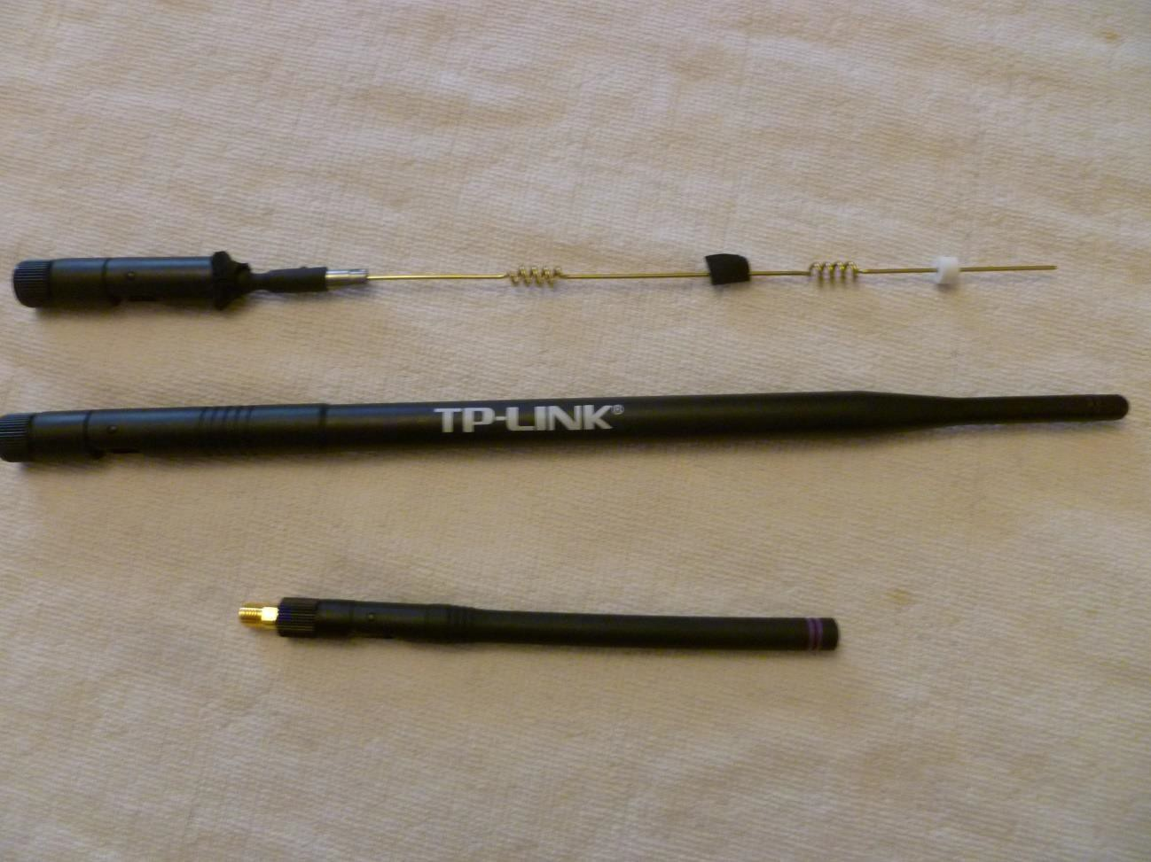
Gain
.Antennas used in current testing. A standard 2.15 dBi 1/2 wave dipole is at the bottom of the photo. The other two antennas show the TP Link 8 dBi collinear dipole. At the top is the TP Link antenna with plastic jacket removed
^{to show construction} Dr. Ted Anderson; Haleakala R&D; Proprietary
70

Slide 71
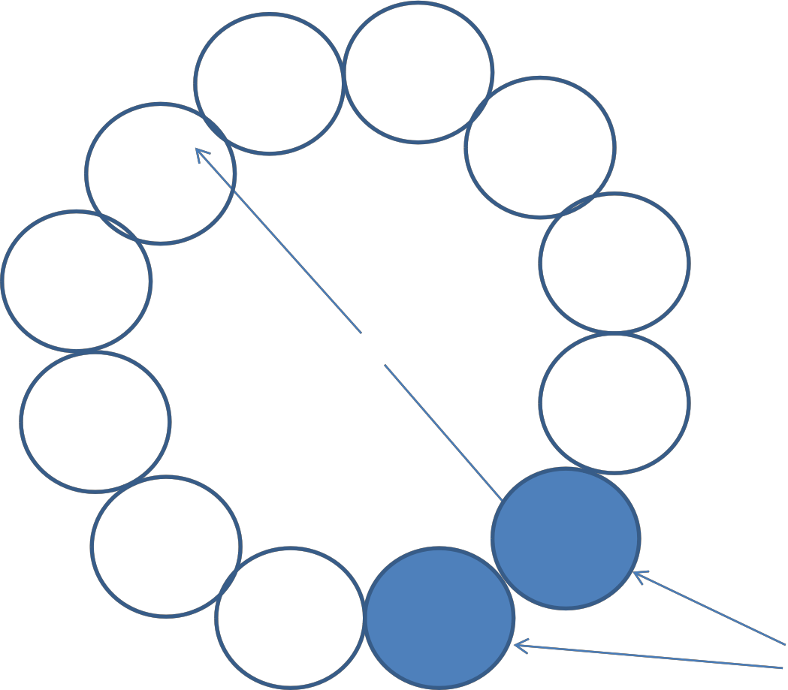
Plasma tubes turned on.
d
Plasma tubes turned off. (Aperture)
Circular cavity using plasma tubes. d is the diameter used for resonant frequency calculations.
Dr. Ted Anderson; Haleakala R&D; Proprietary
71

Slide 72
Gain
We did a network analyzer plot (HP 8753C) of VSWR vs. Frequency for the TP-link antenna, which shows a VSWR of less than 1.25 : 1 from 2.4 GHz to 2.6 GHz.
Next we calculated the anticipated resonant frequencies of the circular
cavity created by the circular array of plasma tubes.
The second peak (kd= 8) appears to be the most useful for our new smart antenna. The circular cavity resonance corresponding to kd = 8 is:
Dr. Ted Anderson; Haleakala R&D; Proprietary
72

Slide 73
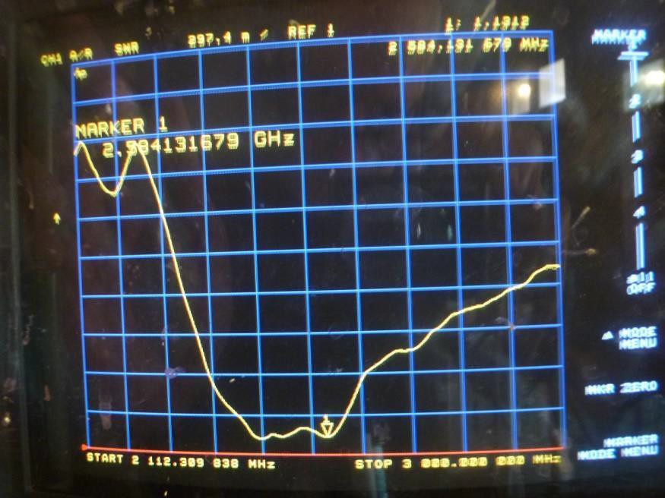
Gain: VSWR
Figure 1. VSWR of D-Link co-linear antenna. VSWR is less than 1.25 : 1 from 2.4-2.6 GHz.
Dr. Ted Anderson; Haleakala R&D; Proprietary
73

Slide 74
Gain
We experimentally measure a cavity resonance of 2.6 GHz which confirms the above calculation.
This 2.6 GHz resonance fortunately is in the low VSWR (<1.25 : 1) frequency range of our D-Link co-linear antenna; allowing us to use the D-Link antenna without modification.
We still see a cavity resonance of 2.1 GHz, but this frequency does not correspond to any of the wave number peaks
Dr. Ted Anderson; Haleakala R&D; Proprietary
74

Slide 75
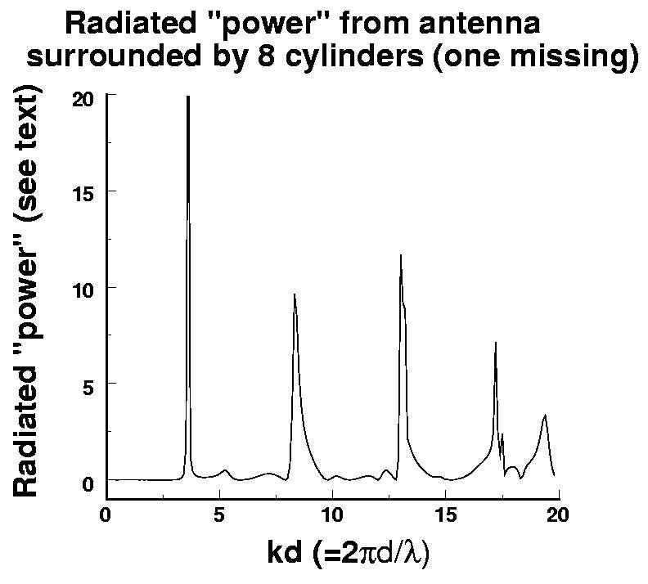
Gain
Figure 1. Plot of the radiated flux in the far field. T his quantity is obtained by integrating the P o ynting vector over a cylindrical surface of in the far field.
Dr. Ted Anderson; Haleakala R&D; Proprietary
75

Slide 76
Gain
We calculated, the anticipated resonant frequencies of the circular cavity created by the circular array of tubes.
The second peak (kd= 8) appears to be the most useful for our new smart antenna.
The circular cavity resonance corresponding to kd = 8 is:
λ = 2πd / k where d = diameter of cavity
λ = 2π 15cm / 8 λ = 11.7cm
and f = 2.56 GHz
The cavity diameter, d, used in this calculation is assumed to be the circle through the centerline of each fluorescent tube.
Use first resonance (kd=3) for smart plasma antenna to decrease size.
Dr. Ted Anderson; Haleakala R&D; Proprietary
Proprietary
.
76

Slide 77
_{340.0}3₀50.00₁₅
10.00
20.00_{30.00}
40.00
50.00
60.00
70.00
80.00
330.00
320.00
310.00
300.00
290.00
280.00
270.00
260.00
250.00
240.00
230.00
220.00
10
5
0
-5
-10
-15
-20
-25
90.00
100.00
110.00
120.00
130.00
140.00
150.00
Series 1
Series 2
210.00
200.0₁0_{90.00}
_{180.0}1₀70.00
160.00
Figure 4. Radiation pattern for Smart Plasma Antenna with D-Link co-linear dipole in center.
Signal levels in dBi.
Series 1 (Blue): Radiation pattern with D-Link antenna at center (dBi). D-Link antenna has gain of 8dBi.
Series 2 (Red): Zero dBi reference.
Dr. Ted Anderson; Haleakala R&D; Proprietary
77

Slide 78
Gain
Use first resonance for smart plasma antenna to decrease size.
Dr. Ted Anderson; Haleakala R&D; Proprietary
78

Slide 79
Gain
In summary:
Cavity resonant frequency for maximum gain has been calculated and
experimentally confirmed.
A high gain co-linear dipole has been used as the center metal antenna to achieve a forward gain of 13 dBi which is comparable to many commercially available antennas at 2.4 GHz. Another 3 to 6 dBi is achieved using plasma lens focusing for a total of 16 dBi to 19 dBi. This is a very good gain for an antenna which is smart, steerable and compact.
A simple field strength meter has been built to allow faster antenna setup and checkout.
We used Ted Anderson theory for multiple resonances in the smart plasma antenna.
Dr. Ted Anderson; Haleakala R&D; Proprietary
79

Slide 80
Gain
Field Strength Meter we Built for These Applications.
For measurements of radiated power we have been using a receiving antenna connected to a spectrum analyzer; however a simple Field Strength Meter is easier to use for quick measurements and to check that individual plasma tubes are functioning properly.
These Field Strength Meters are readily commercially available for the VHF and UHF bands, but we have not found a reasonably priced analog meter for 2.4 GHz.
We therefore built our own meter shown.
  The block diagram is shown. A 2.4 GHz receives the transmitted signal and is detected by an HP 423 Crystal Diode.
    The DC voltage from the crystal detector is amplified and displayed on a
large analog meter.
    This meter has made day to day measurements easier and faster.
Dr. Ted Anderson; Haleakala R&D; Proprietary
80

Slide 81
Noise
Dr. Ted Anderson; Haleakala R&D; Proprietary
81

Slide 82
Questions
1. The radios may operate down to 1.6 MHz. Pulsing with high voltage is seen as creating RF
noise. What is the noise spectrum created? Will it be compatible with transmit and receive RF coms in a cosite environment?
Dr. Ted Anderson; Haleakala R&D;
82
Proprietary

Slide 83
Noise
We have measured noise generated by our pulsed plasma antenna.
Noise generated by the plasma is visible only at frequencies below about 120 MHz.
Above this this frequency the plasma noise is near or below the noise floor of the spectrum analyzer (approx. -120 dBm
Previous tests is a similar measurement that we took with using a B&K Precision 3
GHz spectrum analyzer.
We see noise visible (above spectrum analyzer noise floor) below about150 MHz.
The marker is set at 268 MHz and measures a level of -119.2 dBm.
The peaks seen are from ambient radio signals; not seen in Figure because of the shielded chamber used. The last figure is a spectrum taken with the plasma turned off. The radio peaks are of course still seen and the marker at 268 MHz measures -
118.8 dBm.
Dr. Ted Anderson; Haleakala R&D; Proprietary
83

Slide 84
Noise
We are not seeing noise from our plasma antenna above a
frequency of about 150 MHz.
Obviously there is noise being generated in the microwave frequency range, as proven by the use of a fluorescent lamp as a noise measurement system.
We think the reason for this is that the HP noise generating device uses a resonant waveguide cavity to amplify the noise.
Our measurements used a metal receiving antenna (Dipole or
log-periodic).
Dr. Ted Anderson; Haleakala R&D; Proprietary
84

Slide 85
Noise
Our measurements are limited to frequencies below 3 GHz as that is the limit of our spectrum analyzer. We have diode crystal detectors up to 50 GHz but they are not sensitive enough to measure the noise.
Our noise measurements are encouraging.
We do not see plasma generated noise with a level higher than about -120
dBm between 150 to 3000 MHz.
Our measurement set-up is similar to the geometry of our plasma antennas, indicating that we should see noise interference lower than about -120 dBm assuming a bandwidth of 300 kHz.
Dr. Ted Anderson; Haleakala R&D; Proprietary
85

Slide 86
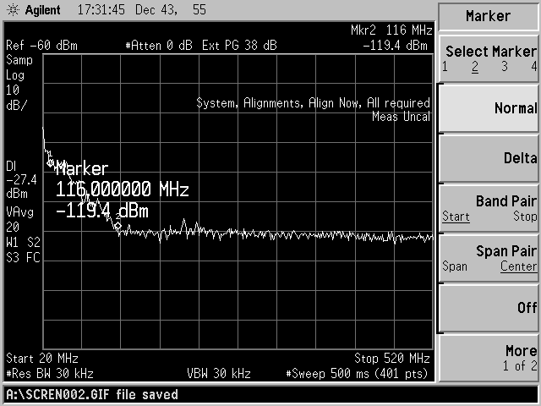
Noise
Radiated noise from pulsed plasma antenna. Received by a log-periodic antenna placed ~5 ft. from plasma antenna. These data were taken inside an anechoic chamber; therefore no background radio noise is seen. Video BW=300kHz.
Dr. Ted Anderson; Haleakala R&D; Proprietary
86

Slide 87
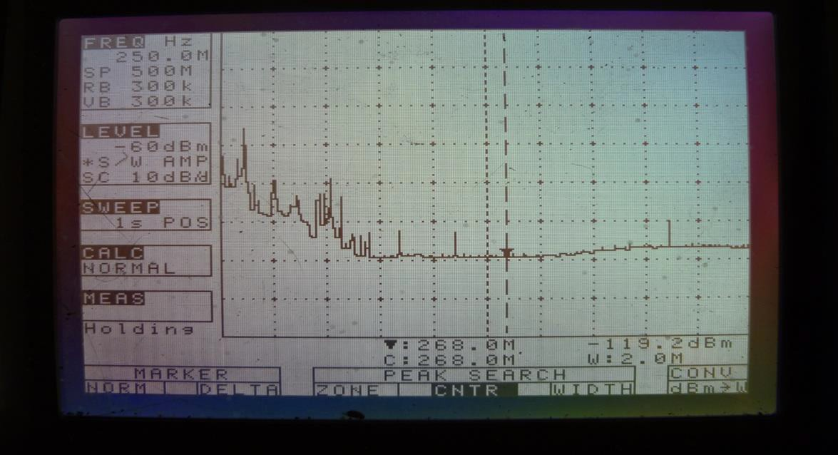
Noise
Radiated noise from 1.5 in. dia. fluorescent lamp pulsed at 10A peak. Peaks superimposed on noise are from ambient radio signals. Received by 1 ft. length “rubber ducky” antenna placed 1.5 ft. from plasma antenna. Video BW=300 kHz.
Dr. Ted Anderson; Haleakala R&D; Proprietary
87

Slide 88
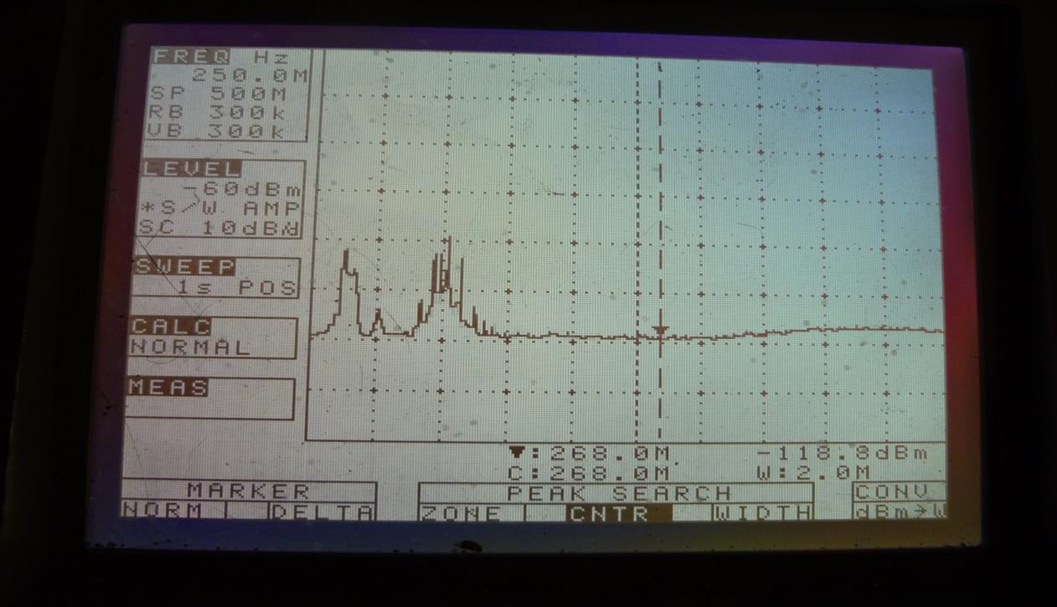
Noise
Spectrum with plasma off; showing baseline noise floor and radio signals.
Dr. Ted Anderson; Haleakala R&D; Proprietary
88

Slide 89
Thermal Noise in a Metal Antenna
Johnson-Nyquist Noise equation:
(1)
N = 4Rk_{B}T
―Fundamentals of Statistical and Thermal Physics‖, by F. Reif, McGraw- Hill, 1965, pp. 587-589 for the standard Nyquist’s Theorem and pp. 585- 587 for the Wiener-Khintchine Theorem.
where N is the noise spectrum as V²/Hz
R is the resistance of the object in Ohms (not Ohms per unit length)
k_{B} is Boltzmann’s constant in Joules per degree K, and
T is the temperature in degrees Kelvin.

Slide 90
Thermal Noise in a Plasma Antenna
•
Rigorous derivation of thermal noise shows that the approximate expression of the Johnson-Nyquist Theorem becomes:
1
N (T , R,ω,ν ) = 4k TR
_{ω}2
B
•
1+
2
(2)
where
ν
is the electron-atom collision frequency and
ω = 2π f
is the operating antenna radian frequency
•
Ref:
Dr. Ted Anderson, 2000 IEEE Symposium Record, Volume 2,
pages 695-698, ISBN 0-7803-5677-2
•
Derived independently by Professor Igor Alexeff in November 2007.

Slide 91
Plasma Noise when the RF Frequency is Less
Than the Collision Frequency
The limit of a very large collision frequency ν
as compared to the
antenna operating frequency (which is characteristic of a metal
antenna)
ω << v
equation (2) reduces to equation (1) characteristic of thermal noise
in a metal:
⎛
⎞
⎜
N (T , R,ω,ν ) = 4k TR
1
⎟
⇒ 4k TR
⎜
_{ω}2
⎟
B
⎜
⎟
B
⎜ 1+ _{ν 2}
⎟
⎝
⎠

Slide 92
Thermal Noise as a Function of Increasing
Frequency
The thermal noise in a plasma antenna decreases as compared to a metal antenna when the operating frequency increases:
  The thermal noise in a metal antenna is higher at higher operating frequencies because of the decreasing skin depth and corresponding higher electrical resistance.
  The thermal noise of the plasma antenna decreases as the operating frequency
ω increases, especially when ω>>v.
⎛
⎜
N (T , R,ω,ν ) = 4k_{B}TR ⎜
⎞
⎟
_{v}2
1
_{ω2} ⎟ ⇒ 4k_{B}TR _{ω2}
⎜
⎟
⎜1+ _{ν 2}
⎟
⎝
⎠

Slide 93

Thermal Noise in a Metal (Cu) Antenna
Frequency of operation: 10 GHz (3 cm wavelength).
If we compared metals directly to plasmas, the collision freq v_{metal} ≅ 1 THz [Rief].
Resistance of the antenna. Assume a rod 1 cm square in cross section and 3 cm long. The resistivity of copper is ρ=1.692x10⁻⁶ Ω-cm (―Handbook of Chemistry
and Physics‖)
Neglecting skin depth effects, R= 5.076x10⁻⁶ Ohms. Since we are operating at 10 GHz, we must consider skin depth effects on antenna resistance.
Skin depth is δ =
^{2ρ} = 6.5x10⁻⁵ cm
The effective resistance of the
ωμ
antenna is determined by considering δ around the perimeter of the rod
ρ 1.692x10⁻⁶ Ωcm 3cm
R = =
= .0195Ω
A 6.5x10⁻⁵ cm (4) 1cm
Thermal Noise for a Cu antenna at 300°K is
N = 4Rk T = 4(.0195Ω)(1.386x10⁻²³ J / K)(300K) = 3.24x10⁻²²V ² / Hz
B
Ref: Reif, F., Fundamentals of Statistical and Thermal Physics, McGraw-Hill, New York, NY, 1965

Slide 94
Calculating the Collision Frequency v for Fluorescent Tube Plasma
The pressure in a fluorescent tube is a maximum of 2 mm hg.
The electron-gas atom scattering cross section corresponds to an electron temperature of
1 eV. It is a Ramsauer Minimum [Fig. 2.3, Cobine]
The mean-free-path is 1 cm at a pressure of 1 mm hg. This gives a scattering cross section of A_{s} = 2.8 x 10⁻¹⁷ cm² (It is at the Ramsauer minimum) at a pressure of 1 mm hg.
The electron velocity corresponds to 1 electron volt. The thermal velocity is
v =
k_{B}T ₌
(1.386x10
−23
⁾⁽³⁰⁰⁾ = 1.351x10⁷ cm/sec
m
9.11x10⁻³¹
where v is the velocity, K is Boltzmann’s constant, T is the electron temperature, and m is the electron mass.
Inserting the proper values gives an electron thermal velocity of v = 4.2 x 10⁷ cm/sec.
Using the atom density at 1 mm hg to be n=7.02 x 10¹⁶/cm³, the collision frequency is
f = A vn = (2.8x10⁻¹⁷ )(4.2x10⁷ )(7.02x10¹⁶ ) / sec = 82.55 MHz
c s
At the tube walls (1 cm diameter), the collision frequency exceeds this.
Ref: Cobine, James D., Gaseous Conductors, Theory and Engineering Applications, Mc-Graw Hill, New York, NY, 1941.

Slide 95
Calculating the Resistance and Noise of the Plasma in the Tube
Cobine shows that the voltage drop across a 9 inch tube is 45 volts and 108 volts across a 48 inch tube.
Subtracting these (which include the cathode voltage drops), and to find the voltage
drop on the plasma, we get 1.615 V/in, or 0.636 V/cm.
The peak current through the tube is 0.42 Amps. The resistance of 1.52 Ω/cm. For a 3 cm long column of plasma, R = 4.56 Ω.
For the plasma antenna at 10 GHz, the Noise is
⎛
⎞
⎟
= 4(1.386x10⁻²³ )(300)(4.56)
⎜
N (T , R,ω,ν ) = 4k TR
1
1
B
⎜
₂ ⎟
2
= 5.099x10⁻²⁴ V ² Hz
⎜ 1+ ^{ω}
⎟
⎡ 2π (10, 000) ⎤
⎜
₂ ⎟
1+ ⎢
⎥
⎝ ν ⎠
2π (82)
⎣ ⎦
In the microwave frequency range, the noise in the plasma antenna is much less than the metal antenna. At HF frequencies, the inequality is reversed. However, this can be address that by reducing the gas pressure in custom made plasma tubes.
^{N}metal
= 3.24 x 10⁻²² V²/Hz
N_{plasma} = 5.10 x 10⁻²⁴ V²/Hz

Slide 96
Lowering Plasma Thermal Noise
Other factors which further lower thermal noise in a plasma antenna:
  Operating the plasma antennas in the energy region where
the Ramsauer-Townsend phenomenon is in effect.
  Operating the plasma antenna in the afterglow state may further reduce thermal noise
  Reducing plasma pressure, plasma temperature, and plasma resistance
  Reducing electron temperature
    Igor Alexeff found varies electron temperature by confining the hot electrons in a positive potential well.
    By using a hot, electron emitting filament, we were able to replace the hot electrons with cold ones.
    The temperature change was verified by observing the velocity change of ion-acoustic waves.

Slide 97
Containment of the Plasma
We have used mostly fluorescent tubes to do our plasma research and demonstrate plasma antennas because they are readily available and inexpensive. We have also filled custom shaped glass tubes with gas and placed electrodes in them.
Ruggedized tubes made with materials compatible for composite embedment are needed if plasma antennas are to be fielded. Materials which can survive plasma bombardment over an extended period must be used.

Slide 98
Conclusions on Plasma Antenna Thermal Noise
Thermal noise in a plasma antenna decreases as the frequency increases. The opposite occurs in a metallic antenna due to the skin effect.
  High G/T antennas could benefit from use of plasmas as reflectors, for example.
  Higher data rates in a low thermal noise plasma antenna system with plasma feeds and a low noise receiver.
In addition to plasma antennas, the low thermal noise results and concepts apply to plasma antenna arrays, plasma frequency selective surfaces, nested plasma antennas, stacked plasma antenna arrays, plasma waveguides, plasma coaxial cables, and plasma shields.

Slide 99
Smart Plasma Antenna Wi-Fi
Dr. Ted Anderson; Haleakala R&D; Proprietary
99

Slide 100
Questions
1.Details on the Haleakala Wi-Fi
implements are requested.
Dr. Ted Anderson; Haleakala R&D; Proprietary
100

Slide 101
This test was previously done using our Smart Antenna with an 8 dB collinear antenna in the center. We have repeated the test using the standard ½ wave dipole used in the stock router.
We have removed the standard transmitting ½ λ dipole antenna from a Cisco Linksys 2.45 GHz Router; and then connected the router to our Smart Plasma Antenna via a coaxial cable.The router with smart antenna was placed on a turntable and located in the front yard of a typical neighborhood with nearby houses trees and shrubs.
An LG Smartphone was used to test WiFi useable range by observing the phone’s signal strength graphic with
three bars indicating relative signal strength:
Dr. Ted Anderson; Haleakala R&D; Proprietary
101

Slide 102
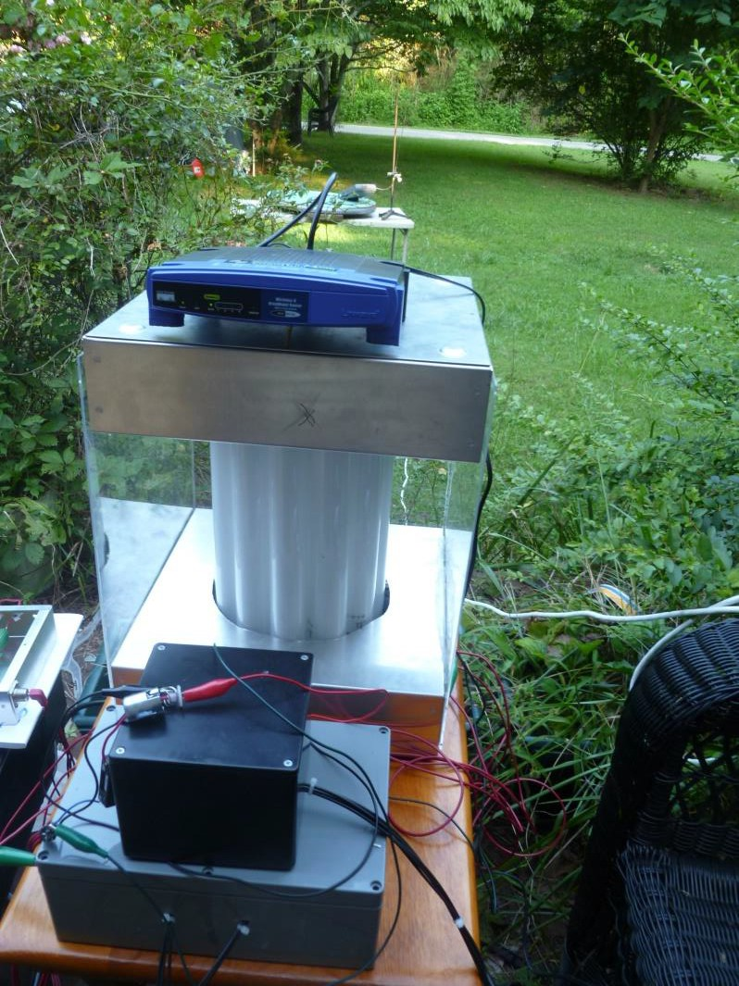
WiFi router (Blue box) with Smart Plasma Antenna. Receiving antenna with spectrum analyzer is seen in the background.
Dr. Ted Anderson; Haleakala R&D; Proprietary
102

Slide 103
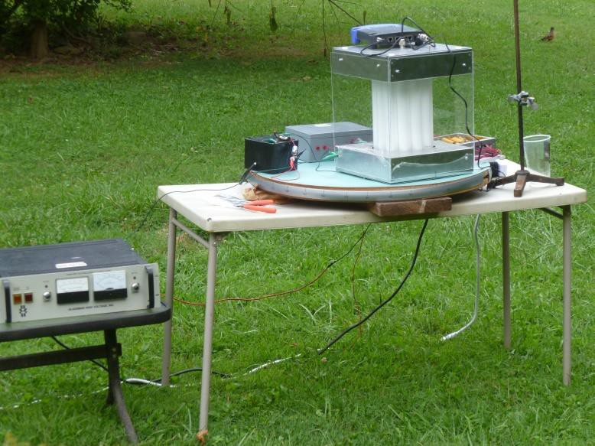
Smart Plasma Antenna with Wi-Fi router on turn table.
Dr. Ted Anderson; Haleakala R&D; Proprietary
103

Slide 104
The smartphone was slowly moved away from the router/antenna until the signal strength diminished to the point where the bar disappeared leaving the lower two bars and dot, and this distance from the antenna recorded. Distances were measured with the following conditions:
All plasma tubes turned off. Only dipole antenna remaining: 186 ft.
Directional beam aimed toward phone (Two tubes off):
234 ft.
Directional beam aimed toward phone (Four tubes off):
292 ft.
Dr. Ted Anderson; Haleakala R&D; Proprietary
104

Slide 105
Reconfigurable Beam Lensing (beam focusing and spreading) and Reconfigurable Steering with Refraction through a Plasma
Dr. Ted Anderson; Haleakala R&D; Proprietary

Slide 106
Beam Lensing and Steering with Refraction
Antenna beam focusing, beam spreading, and beam
steering using refraction of RF waves in a plasma.
This is our first iteration of the plasma lens work and it can only improve. We found it was easier to show the lensing effects of plasma at 24 GHz since the size and shape of COTS plasma tubes are amenable to a 24 GHz.
These effects all scale according to wavelength.
Cylindrical annular rings of plasma are the best way to control the plasma density variations of plasma to optimize the engineering effects of plasma refraction to control beam focusing, beam spreading, and beam steering
Dr. Ted Anderson; Haleakala R&D; Proprietary

Slide 107
Beam Lensing and Steering with
Refraction
We have demonstrated the ability to use a plasma for manipulation of antenna signals by focusing a wide beam into a more narrow beam and also by steering the beam.
Shows the experimental set-up for beam steering and lensing. A narrow-beam 24 GHz signal is directed into the side of a 1.5 inch diameter plasma tube.
Metal shields are on both sides of the plasma tube to block any
extraneous signals from passing through the plasma tube.
If the electron plasma frequency (wp) of the plasma is lower than the signal frequency (24 GHz in our case) then the phase velocity (V_{p}) of the signal is faster than the speed of light in a vacuum.
•
V_{p} = C / (1- (wp/w)^2)^{1/2}
(ω
= 2πf)
Dr. Ted Anderson; Haleakala R&D; Proprietary

Slide 108
Beam Lensing and Steering with
Refraction
This change in velocity of the signal inside the plasma results in a lensing effect if the beam passes through varying lengths of plasma similar to light passing through glass of varying thickness to make a lens.
But there is an important and interesting difference between an ordinary lens made of glass or plastic and a plasma lens:
The glass lens slows-down the signal while a plasma lens speeds-up the signal.
Therefore a convex glass lens focuses a signal to a point while a convex plasma diverges the signal similar to a concave glass lens that diverges the signal while a concave plasma lens focuses to a point.
We have built converging and diverging plasma lenses using plasma tubes. A single plasma tube with the beam passing through its diameter acts as a diverging plasma lens and two plasma tube side-by-side form a converging (focusing) lens.
Note: Plasma focusing lenses are concave and plasma spreading lenses are convex. The terms concave and convex in plasma lenses are opposite of the terms of lenses in optics.
Dr. Ted Anderson; Haleakala R&D; Proprietary

Slide 109
Beam Lensing and Steering with
Refraction
We have built the focusing set-up for beam shown.
A 24 GHz, 5 mW Gunn diode is used as the microwave source with the signal radiating from the open waveguide, which gives a unfocused microwave output.
This setup allows us to focus the beam in the forward direction resulting in a gain of 2 (3 dB).
This is our first iteration of the engineering of plasma lensing and it can only get better.
Dr. Ted Anderson; Haleakala R&D; Proprietary

Slide 110
Beam Lensing and Steering with
Refraction
We are the only group that has utilized a pulsed high voltage power supply to give a much higher average plasma density.
We show an interesting effect caused by the initial high plasma density at the time of the pulse followed by a decay in plasma density as ions drift to the wall.
Dr. Ted Anderson; Haleakala R&D; Proprietary
110

Slide 111
Beam Lensing and Steering with
Refraction
In regard to a relatively lower pulse current:
  The focusing effect occurs immediately after the current
pulse but stops as current decreases.
  Using a higher current (8 A), that best focusing occurs later after the pulse. These figures indicate that focusing can be “tuned” by changing density of the plasma inside the tube.
This ability to tune the focusing of a RF beam is very useful because the same lensing structure can be used with different frequencies and plasma densities to vary focal length as needed.
Dr. Ted Anderson; Haleakala R&D; Proprietary

Slide 112
24 GH Diode Transmitter
Fluorescent Lamps 1.5 dia.
Dr. Ted Anderson; Haleakala R&D; Proprietary

Slide 113
Horn with plastic lens
24 GHz Transmitter
Dr. Ted Anderson; Haleakala R&D; Proprietary

Slide 114
HV Pulsing Circuit
24 Ghz Transmitter
Horn with collimating lens
-90 deg
90 deg
Turntable
1.5 in. dia. Fluorescent Lamp
Aluminum Shields
0 deg
Keithley Micro- Voltmeter
Wire Stub
Microwave diode Detector
^{Set-u}D^{p}r.^{fo}T^{r}e^{m}d^{e}A^{as}n^{u}d^{ri}e^{n}r^{g}s^{p}o^{l}n^{as};^{m}Hªa^{l}l^{e}e^{n}a^{s}k^{in}a^{g}la^{ef}R^{fe}&^{ct}D; Proprietary

Slide 115
Beam Focusing with Plasma Lenses
Dr. Ted Anderson; Haleakala R&D; Proprietary

Slide 116

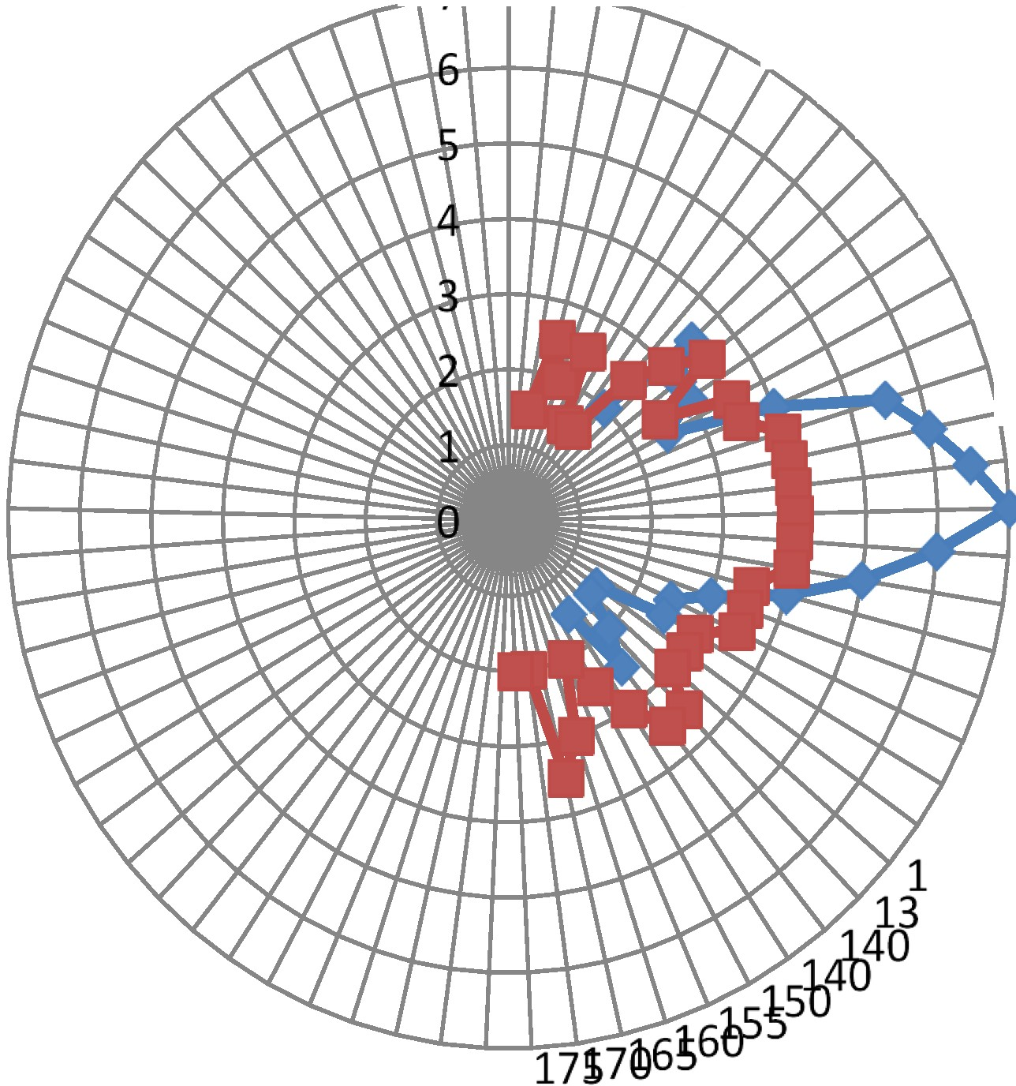
0
.l..r--r-.,..::; ,1J 01520
2 540
45_{so}
55
60
65
70
75
. 80
85
--1---t- 90
---r- 95
100
105
110
115
120
125
30
5
24 GHz beam focus with plasma. Red line is with no plasma. Blue line is with plasma. Note that the plasma focus increases beam amplitude by a factor of two compared to no plasma (,....,3 dB gain)
Dr. Ted Anderson; Haleakala R&D; Proprietary

Slide 117
Beam Lensing and Steering with
Refraction
In the antenna beam focusing experiment, the beam passes through (and between) two side-by- side fluorescent bulbs.
The flat trace at the bottom of the screen is the zero-level for the microwave signal as detected by an 18-26 GHz diode detector.
The flat trace near the middle of the screen is the microwave signal with no plasma.
The top trace shows the effect on the microwave beam caused by refraction and focusing caused by the plasma inside the tubes.
Dr. Ted Anderson; Haleakala R&D; Proprietary

Slide 118
Beam Lensing and Steering with
Refraction
The fast drop in amplitude (left of screen) coincides
with a short current pulse (4 A, 5 μs).
This relatively high current pulse produces a high plasma density that reflects most of the 24 GHz beam.
The plasma ionizing current ends after 5 μs, but the plasma ion density takes much longer ( 1 ms) to decay; resulting in the increasing amplitude with time shown in the figure.
The maximum signal amplitude (right side of trace) occurs when plasma density is optimum for focus of the beam; and gives a gain compared to unfocused signal of a factor of two (3 dB).
Dr. Ted Anderson; Haleakala R&D; Proprietary

Slide 119
Beam Lensing and Steering with
Refraction
We show the focusing effect of a relatively lower pulsed current (3 A). The beginning of each drop in signal level corresponds to the current pulse; resulting in a dip in signal level (reflection) that quickly recovers to more optimum focusing as plasma density decreases.
Dr. Ted Anderson; Haleakala R&D; Proprietary

Slide 120
Beam Lensing and Steering with
Refraction
Peak Current in pulse vs DC from power supply
Peak ionizing currents are rather high (2-20 A), but current required from the DC power supply is much lower:
A 3 A pulse requires 15 mA DC from power supply.
A 10 A pulse requires 40 mA DC from power supply.
Dr. Ted Anderson; Haleakala R&D; Proprietary
120

Slide 121
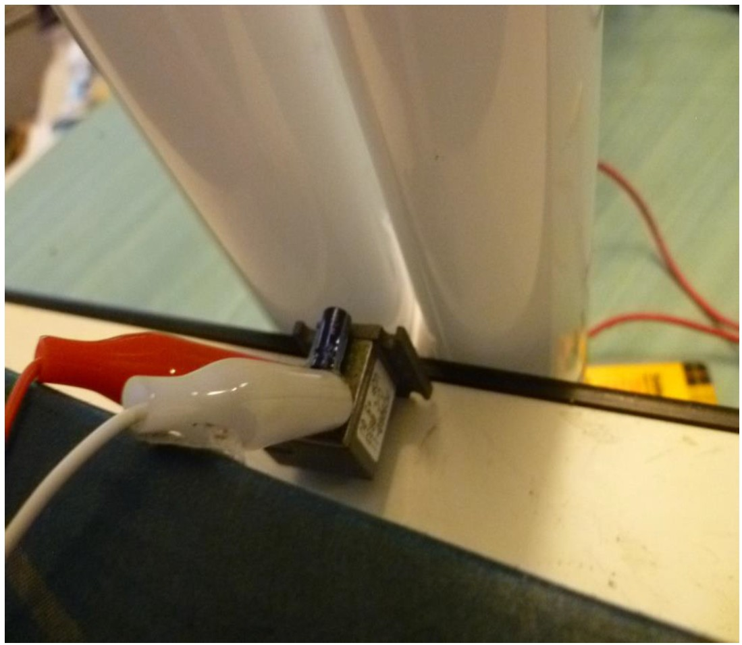
. Plasma focusing experimental setup. Gunn diode 24 GHz transmitter with fluorescent tubes
used for plasma beam focus.
Dr. Ted Anderson; Haleakala R&D; Proprietary

Slide 122
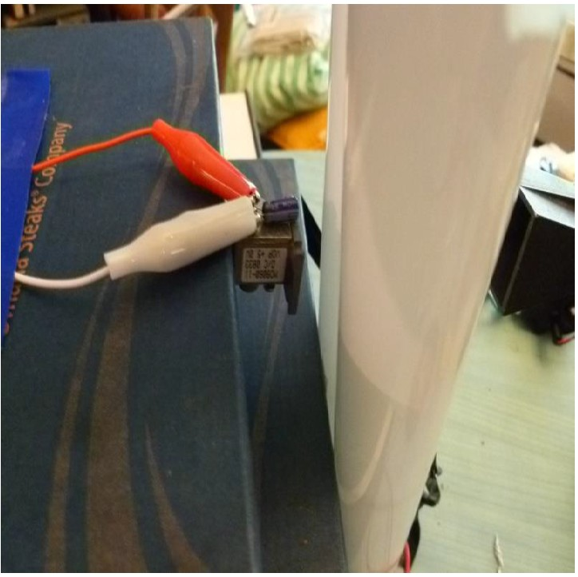
. Plasma focusing experimental setup. Gunn diode 24 GHz transmitter with fluorescent tubes
used for plasma beam focus.
Dr. Ted Anderson; Haleakala R&D; Proprietary

Slide 123
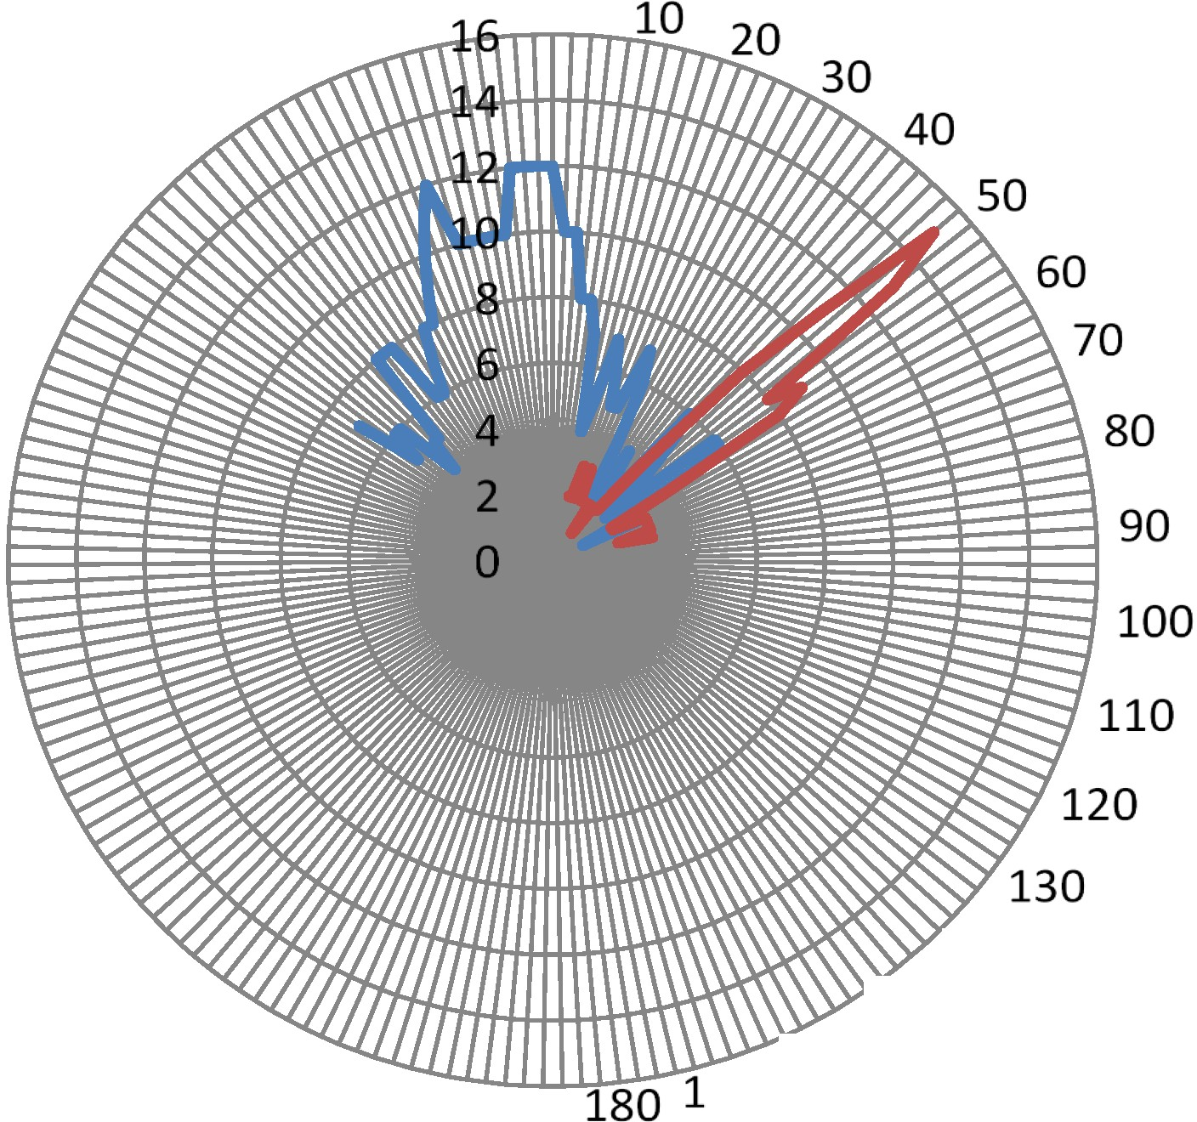
-
-
series 1 series2
140
150
70 160
Plasma Beam steering. Beam is steered "'45 degrees clockwise.
Blue line: No plasma; Red line: 8 A peak ionizing current.
Dr. Ted Anderson; Haleakala R&D; Proprietary

Slide 124
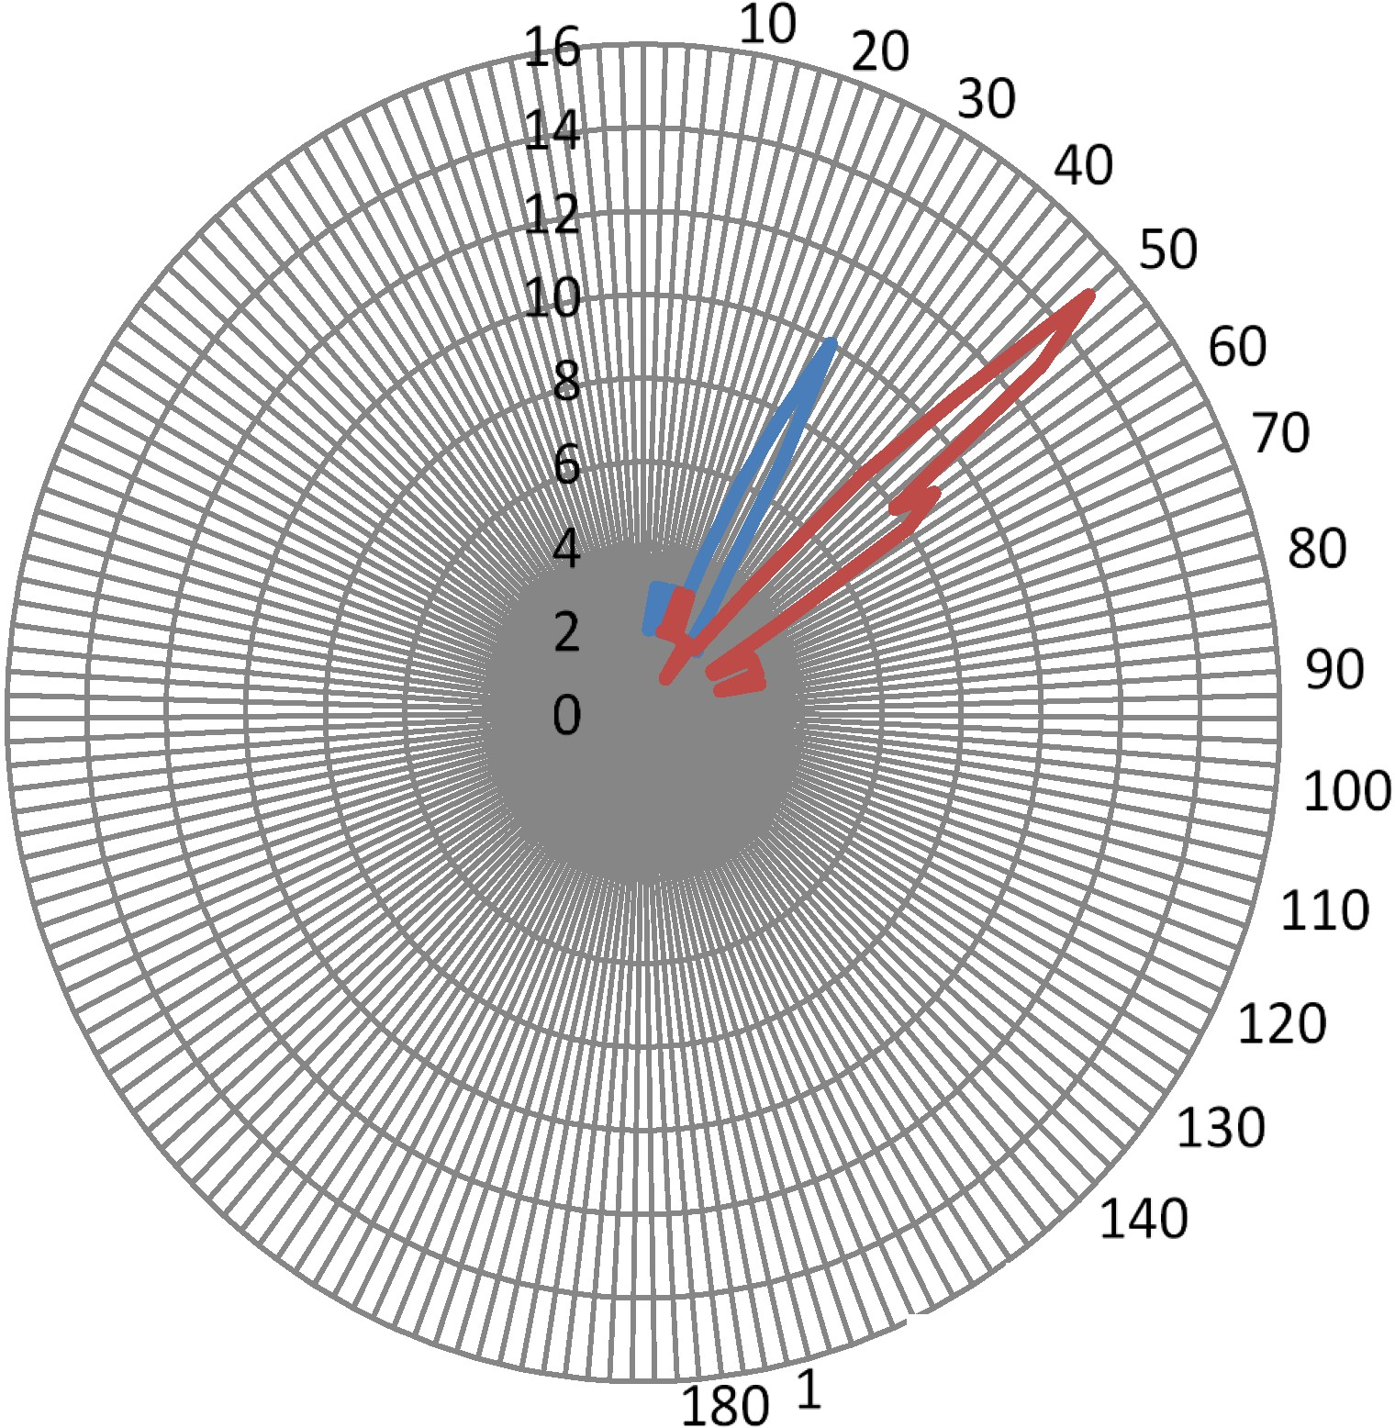
--series 1
--series 2
150
70 160
Beam steering for two different plasma ionizing currents.
Blue line: 5 A peak. Red line: 8 A peak
Dr. Ted Anderson; Haleakala R&D; Proprietary

Slide 125
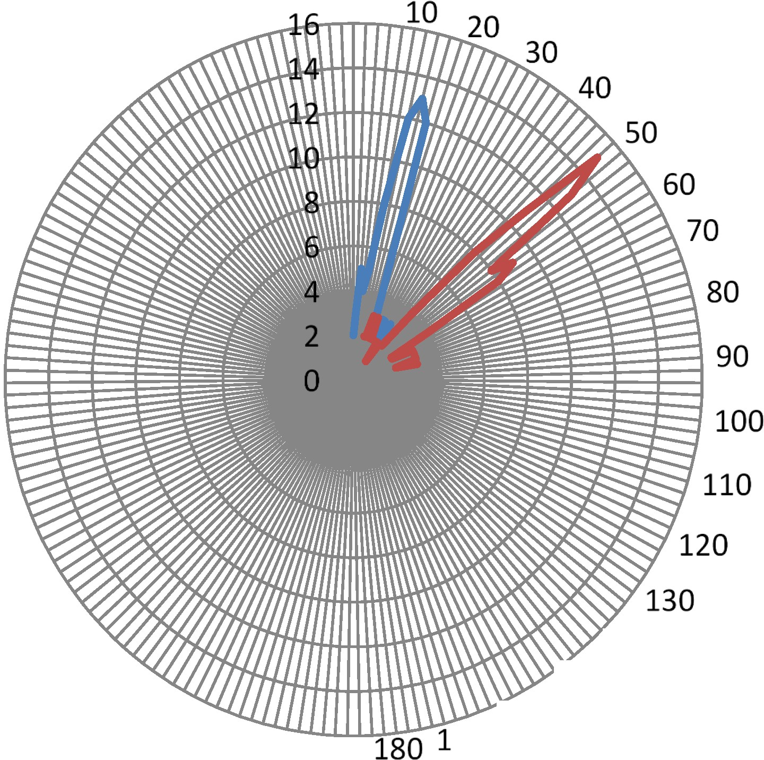
-
-
series 1
Series 2
140
150
70 160
Beam steering for two different plasma ionizing currents,
Blue line: 3 A peak. Red line: 8 A peak
Dr. Ted Anderson; Haleakala R&D; Proprietary

Slide 126
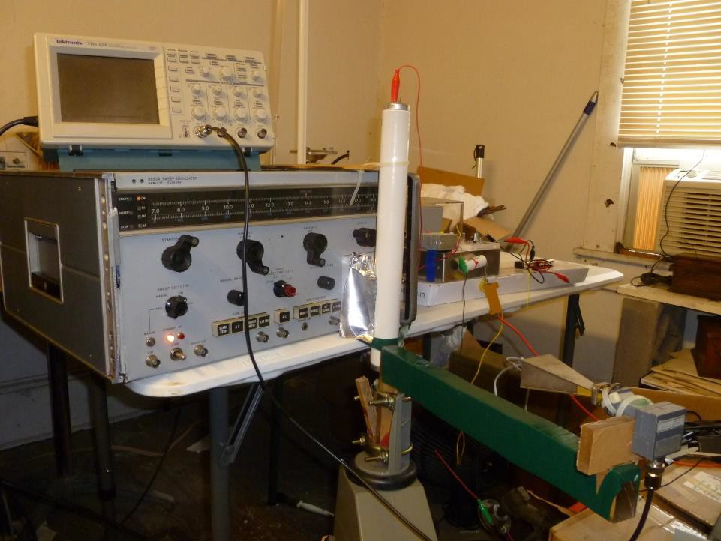
Plasma beam steering experiment. Antenna rotator with holder (green) and receiver horn / detector is in the foreground. The oscilloscope used to monitor the signal waveform is on top
Dr. Ted Anderson; Haleakala R&D; Proprietary
of the HP signal generator. The solid state pulser is to the right of the signal generator.
126

Slide 127
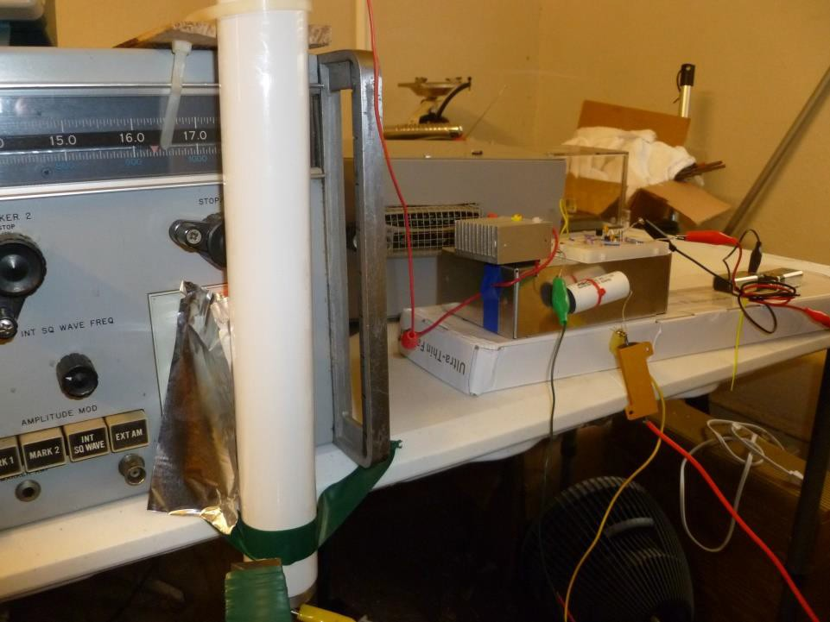
Fluorescent plasma tube is located in front of the output waveguide on the HP signal generator. Aluminum shield on left of tube prevents stray RF from bypassing the plasma. High voltage pulser is on the right.
Dr. Ted Anderson; Haleakala R&D; Proprietary

Slide 128
QUESTIONS
1. As for the GCS direction finder ring array need. The current GCS UHF direction finder has elements that are 1.6 inches tall at 1900 Mhz and 0.7 inches tall at 858 Mhz. Details are in US Patent 6646641. This antenna must be low height even in plasma. It does not seem the plasma reflector is a fit size wise What can Halakala do on this? Plasma element?
Use plasma elements. Harris is using short antenna elements, particularly at 858 MHz Replace the metal elements with plasma.
Harris is concerned about the size of the current smart antenna, For 2 GHz direction
finding, the diameter would need to be ~6 inches. Height of the antenna could be
~4 inches.
Therefore a direction finder using our smart antenna technology could be: 5 inch dia., by 4 inch high.
Dr. Ted Anderson; Haleakala R&D; Proprietary

Slide 129
Refraction
Dr. Ted Anderson; Haleakala R&D; Proprietary
129

Slide 130
Refraction for steering and
focusing in a plasma
Refraction in a plasma depends on:
  Plasma density
  Path length
  Gradient of plasma density
Good results above 23 GHz
Made custom made tube and refraction worked
well at 10 GHz.
Continue work on refraction for focusing and
steering at 2.4 GHz
Dr. Ted Anderson; Haleakala R&D; Proprietary
130

Slide 131
10GHz (X-Band) crystal detector
Signal Path
Angle of Deflection
Custom Plasma Antenna Tube (3 in. dia)
10 GHz Klystron Transmitter
Schematic layout of microwave signal deflection test. Custom plasma tube with 300 micron pressure argon backfill.
Dr. Ted Anderson; Haleakala R&D; Proprietary
131

Slide 132
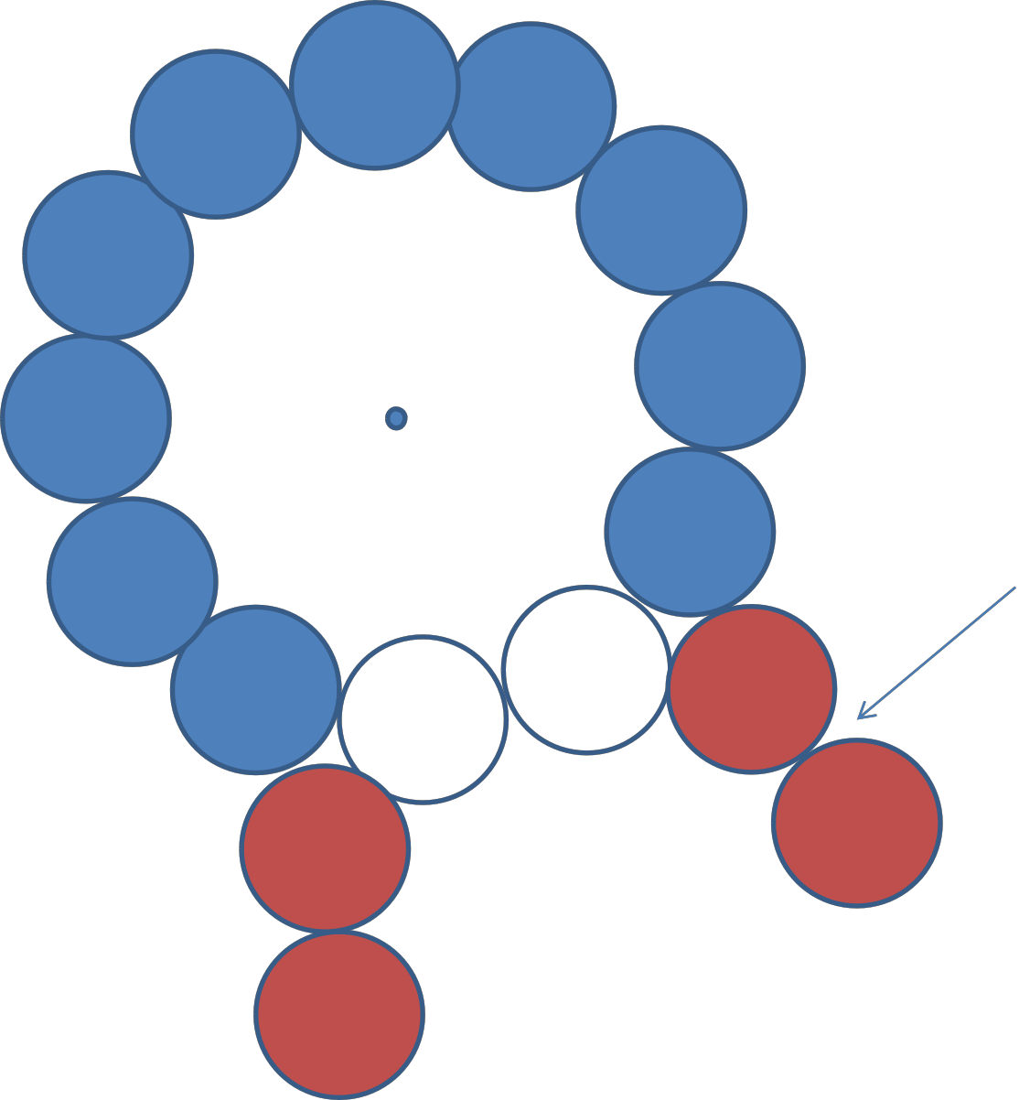
Tubes with lower density added to
focus.
Schematic of tube layout used to experiment with beam focusing.
Dr. Ted Anderson; Haleakala R&D; Proprietary
132

Slide 133
Constant Effective Plasma Density for
Steering and Lensing by Refraction
Dr. Ted Anderson; Haleakala R&D; Proprietary
133
20

Slide 134
Constant Effective Plasma Density for Steering and Lensing by Refraction
Pulsing Circuit and Steady State Operation
Plasma antennas working in the microwave frequency range require a plasma density and average discharge current that is high enough to cause excess thermal heating of the discharge tube.
We are the only group in the world that is solving this problem by using high current pulses (1
– 40 A) separated by a delay of up to 1 ms; which maintains a high average plasma density while keeping average current and power low.
We have recently demonstrated focusing and steering RF beams with plasma antennas.
This requires that the average plasma density stay much more constant that what is needed to reflect or transmit the RF signal. To achieve more constant density we have decreased the time between high current pulses from about 1 ms to 25 μs.
We show an the experimental setup used to measure relative plasma density between current pulses. A 24 GHz transmitter diode is on the right of the tube and an HP Crystal Detector is opposite on the left^{Pr}o^{op}f^{ri}t^{e}h^{ta}e^{ry}tube.
Dr. Ted Anderson; Haleakala R&D; Proprietary
134

Slide 135
Constant Effective Plasma Density for Steering and Lensing by Refraction
For operation at frequencies above about 500 MHz, It is impractical to use steady-state DC current to ionize the plasma.
  The DC current required causes excess heating of the plasma tube and therefore it is not possible to operate for more than a few minutes before stopping to allow the tube to cool.
Ted Anderson and Igor Alexeff solved this problem by using short (~1 µs) high-current pulses to generate the plasma.
  The plasma ion travel time to the wall is relatively slower, and the time
between pulses can therefore be much slower than 1 µs.
In our experimental work so far we have used a time between pusles (period) of about 800-1000 µs.
  This has worked well when using the plasma as an RF reflector since the plasma density needs to only remain high enough to reflect the RF signal.
  However, now that we are using a plasma as a lens and for beam steering, it is becoming more important to have a close to constant plasma density.
Dr. Ted Anderson; Haleakala R&D; Proprietary
135

Slide 136
Constant Effective Plasma Density for Steering and Lensing by
Refraction
•The most obvious way to achieve constant plasma density is to decrease the time between current pulses to the point where the decay of density becomes unimportant.
In the next photo we show an oscilloscope trace showing the transmission of a 24 GHz microwave signal through a plasma.
•The fast drop in signal level occurs at the time of the 1 µs current pulse.
  Transmitted signal then increases exponentially as plasma density decays.
  This set-up is used for lensing and the transmitted signal is larger than the
signal with no plasma, due to the lensing effect.
Dr. Ted Anderson; Haleakala R&D; Proprietary
136

Slide 137
Some Future Work
Dr. Ted Anderson; Haleakala R&D; Proprietary
137

Slide 138
Some Plasma Antenna Applications
Low RCS antennas—function as VHF, UHF Antennas while being invisible to X-/Ku-band radars
  Blade (monopole) antennas
  Bicones
  Loops
Embedded multiband antennas with ultra low co-site interference
High Pass Radome –HEMP Protection
Multifunction Apertures for small platforms (UAVs, Missiles, etc.)
  Nose cone antenna (low freq antennas in front of seeker array)
Reflecting surfaces with frequency selective properties
  Multiband Cassegrain reflectors
  Steerable reflectors
Meta-material properties—can have negative dielectric constant
  Reduce size of cavity type antennas

Slide 139
Future Work
•
Continue work on custom made tubes for optimal size,
performance and ruggedness.
Perfect steering and focusing by refraction.
Continue to increase gain.
Use Xenon gas for easier constant density.
Use first resonance for smart plasma antenna to decrease size.
Continue work on refraction for focusing and steering at 2.4 GHz
Build a half circle smart plasma antenna with plasma tubes in the front and metal reflectors in the back.
Uniform density in annular ring.
Dr. Ted Anderson; Haleakala R&D; Proprietary
139

Slide 140
We can build a smart plasma antenna version of the antenna on the next two slides.
Dr. Ted Anderson; Haleakala R&D; Proprietary
140

Slide 141
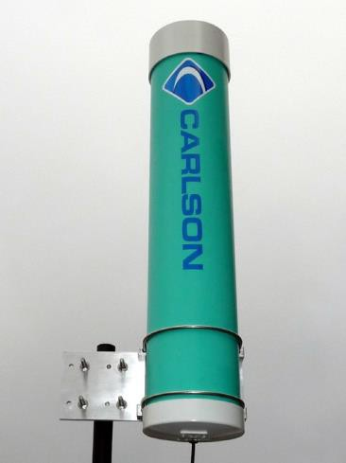
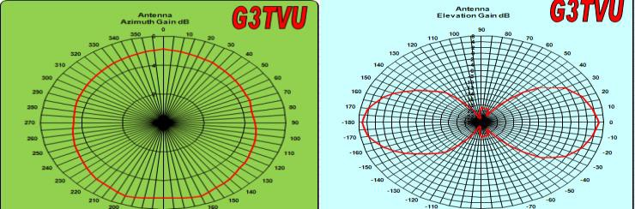
High-Gain Omnidirectional UHF Antenna for RuralConnect® Base Station
Frequency Range Gain
VSWR
Active Elements Radiation Pattern
470 - 790 MHz
5.2 dBi
1:1.8
42 - 2 bays
E plane 360 deg +/- 1dB H plane 29 deg +/- 1dB
32”
6.5”
Linear : Vertical 15 lbs.
8” x 8” x 32”
“N” type female or “F” type male pigtail 50 ohm or 75 ohm (respectively)
UV Resistant PVC
-40 to 70 degrees Celsius
Maximum Height Maximum Diameter Polarization Shipping Weight Carton Dimensions Connector Impedance Enclosure Materials Operating Temp.
Wind Loading with no ice
with 1/2 in. ice
Vertical Mast Mount
Surface Area
2.65 sq ft.
3.22 sq ft
100 mph
67.9 lbs
82.5 lbs
120 mph
97.7 lbs
118.8 lbs
Horizontal and Vertical Performance Plots
Dr. Ted Anderson; Haleakala R&D; Proprietary

Slide 142
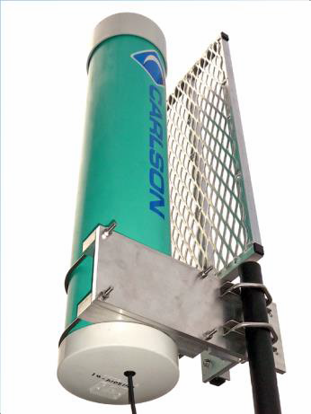

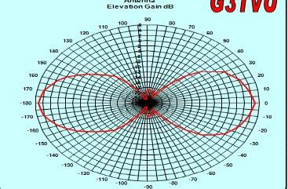

120 - 180° Reflector for RuralConnect®
470 - 790 MHz
10.4 dBi
E plane 120 deg +/- 1dB H plane 32 deg +/- 1dB
36”
12”
Linear : Vertical 14 lbs.
Omni Antenna
Frequency Range Gain
Radiation Pattern
Maximum Height Maximum Width Polarization Shipping Weight
Carton Dimensions Enclosure Materials Operating Temp.
Wind Loading with no ice with 1/2 in. ice
(14” x 2” x 36”)
UV Resistant PVC
-40 to 70 degrees Celsius
Surface Area
4.0 sq ft.
4.5 sq ft
100 mph
102.4 lbs
115.5 lbs
120 mph
147.5 lbs
166.4 lbs
Vertical Mast Mount
0
350 10
Antenna
Azimuth Gain dB
3
340 ¹²
20
²⁹⁰ 320
330
10
8
6
4
2
0
-2
-4
-6
-8
-10
-12
30
40
₂₈₀ 310
50
60
70
270
80
260
90
250
100
240
110
230
220
140
130
120
210
200
190
180
170
160
150
Horizontal and Vertical Performance Plots
Paired with our Omnidirectional Antenna, the reflector is engineered to precisely refocus the 5.2 dBi, 360 degree (azimuth) radiated pattern into a concentrated 10.4 dBi, 120 - 180 degree (azimuth) pattern. This can be very useful when the location of the base station is best suited off to one side from the client pool or you want to share the base site with two or 3 base stations creating sectors. The vertical dipole antenna does not require any field tuning or adjustments over the entire UHF TV band. Available in both 50 ohm and 75 ohm impedances.
Dr. Ted Anderson; Haleakala R&D; Proprietary

