Slide 1

5 G Antenna Systems Conference
September 26, 2019
5G Antenna Systems Conference
Antenna Beam Focusing and Steering with Refraction Through a Plasma for the Advancement of 5G.
Dr. Theodore Anderson,
CEO Haleakala R&D, INC.
www.ionizedgasantennas.com

Slide 2
Reconfigurable Beam Lensing (beam focusing and spreading) and Reconfigurable Steering with Refraction through a Plasma
Dr. Ted Anderson; Haleakala R&D;

Slide 3


Basic Physics of the Conditions of Refraction in the Plasma
The phase speed of electromagnetic waves in a plasma is given by:
Where the plasma frequency is given by:
In this paper we are experimenting in the region where the antenna frequency is greater than the plasma frequency:
In this region refraction and not reflection takes place.

Slide 4
Physical Processes under the Conditions of Refraction in the Plasma
Under the conditions of refraction, the phase speed of electromagnetic waves in a plasma is greater than in free space.
Under the conditions of refraction, the greater the density of the plasma, the greater the phase speed.
Since the plasma density can be reconfigured, the steering and focusing of antenna beams by the physics of refraction through a plasma is reconfigurable.
The amount of refraction through a plasma depends on the path length through a plasma and the change in plasma density over that path length
This physical process can also be considered as a plasma lens.

Slide 5
Beam Lensing and Steering with Refraction
Antenna beam focusing, beam spreading, and beam
steering using refraction of RF waves in a plasma.
This is our first iteration of the plasma lens work and it can only improve. We found it was easier to show the lensing effects of plasma at 24 GHz since the size and shape of COTS plasma tubes are amenable to a 24 GHz.
These effects all scale according to wavelength.
Cylindrical annular rings of plasma are the best way to control the plasma density variations of plasma to optimize the engineering effects of plasma refraction to control beam focusing, beam spreading, and beam steering
Dr. Ted Anderson; Haleakala R&D;

Slide 6
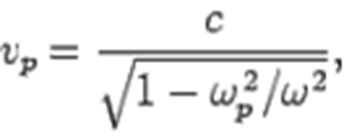
Beam Lensing and Steering with
Refraction
We have demonstrated the ability to use a plasma for manipulation of antenna signals by focusing a wide beam into a more narrow beam and also by steering the beam.
Shows the experimental set-up for beam steering and lensing. A narrow-beam 24 GHz signal is directed into the side of a 1.5 inch diameter plasma tube.
Metal shields are on both sides of the plasma tube to block any
extraneous signals from passing through the plasma tube.
If the electron plasma frequency of the plasma is lower than the signal frequency (24 GHz in our case) then the phase velocity of the signal is faster than the speed of light in a vacuum.
•
Dr. Ted Anderson; Haleakala R&D;

Slide 7
Beam Lensing and Steering with
Refraction
This change in velocity of the signal inside the plasma results in a lensing effect if the beam passes through varying lengths of plasma similar to light passing through glass of varying thickness to make a lens.
But there is an important and interesting difference between an ordinary lens made of glass or plastic and a plasma lens:
The glass lens slows-down the signal while a plasma lens speeds-up the signal.
Therefore a convex glass lens focuses a signal to a point while a convex plasma diverges the signal similar to a concave glass lens that diverges the signal while a concave plasma lens focuses to a point.
We have built converging and diverging plasma lenses using plasma tubes. A single plasma tube with the beam passing through its diameter acts as a diverging plasma lens and two plasma tube side-by-side form a converging (focusing) lens.
Note: Plasma focusing lenses are concave and plasma spreading lenses are convex. The terms concave and convex in plasma lenses are opposite of the terms of lenses in optics.
Dr. Ted Anderson; Haleakala R&D; Proprietary

Slide 8
Beam Lensing and Steering with
Refraction
We have built the focusing set-up for beam shown.
A 24 GHz, 5 mW Gunn diode is used as the microwave source with the signal radiating from the open waveguide, which gives a unfocused microwave output.
This setup allows us to focus the beam in the forward direction resulting in a gain of 2 (3 dB).
This is our first iteration of the engineering of plasma lensing and it can only get better.
Dr. Ted Anderson; Haleakala R&D; Proprietary

Slide 9
Beam Lensing and Steering with
Refraction
We have utilized a pulsed high voltage power supply to give a much higher average plasma density.
Dr. Ted Anderson; Haleakala R&D; Proprietary

Slide 10
Beam Lensing and Steering with
Refraction
In regard to a relatively lower pulse current:
  The focusing effect occurs immediately after the current
pulse but stops as current decreases.
  Peak currents of 3 A and 10 A were used from our pulsing technique.
  Focusing can be “tuned” by changing density of the plasma inside the tube.
This ability to tune the focusing of a RF beam is very useful because the same lensing structure can be used with different frequencies and plasma densities to vary focal length as needed.
Dr. Ted Anderson; Haleakala R&D; Proprietary

Slide 11
24 GH Diode Transmitter
Fluorescent Lamps 1.5 dia.
Dr. Ted Anderson; Haleakala R&D; Proprietary

Slide 12
Horn with plastic lens
24 GHz Transmitter
Dr. Ted Anderson; Haleakala R&D; Proprietary

Slide 13
HV Pulsing Circuit
24 Ghz Transmitter
Horn with collimating lens
-90 deg
90 deg
Turntable
1.5 in. dia. Fluorescent Lamp
Aluminum Shields
0 deg
Keithley Micro- Voltmeter
Wire Stub
Microwave diode Detector

Slide 14
Steering with refraction through the plasma worked at 10 GHz with a custom made tube with plasma.
10GHz (X-Band) crystal detector
Signal Path
Angle of Deflection
Custom Plasma Antenna Tube (3 in. dia)
10 GHz Klystron Transmitter
Schematic layout of microwave signal deflection test. Custom plasma tube with 300 micron pressure argon backfill.
Dr. Ted Anderson; Haleakala R&D; Proprietary

Slide 15
Beam Focusing with Plasma Lenses
Dr. Ted Anderson; Haleakala R&D; Proprietary

Slide 16
Beam Lensing and Steering with
Refraction
In the antenna beam focusing experiment, the beam passes through (and between) two COTS plasma tubes touching.
We used a 18-26 GHz diode detector.
Dr. Ted Anderson; Haleakala R&D;

Slide 17
Beam Lensing and Steering with
Refraction
Peak Current in pulse vs DC from power supply
Peak ionizing currents are rather high (2-20 A), but current required from the DC power supply is much lower:
A 3 A pulse requires 15 mA DC from power supply.
A 10 A pulse requires 40 mA DC from power supply.
Dr. Ted Anderson; Haleakala R&D;

Slide 18
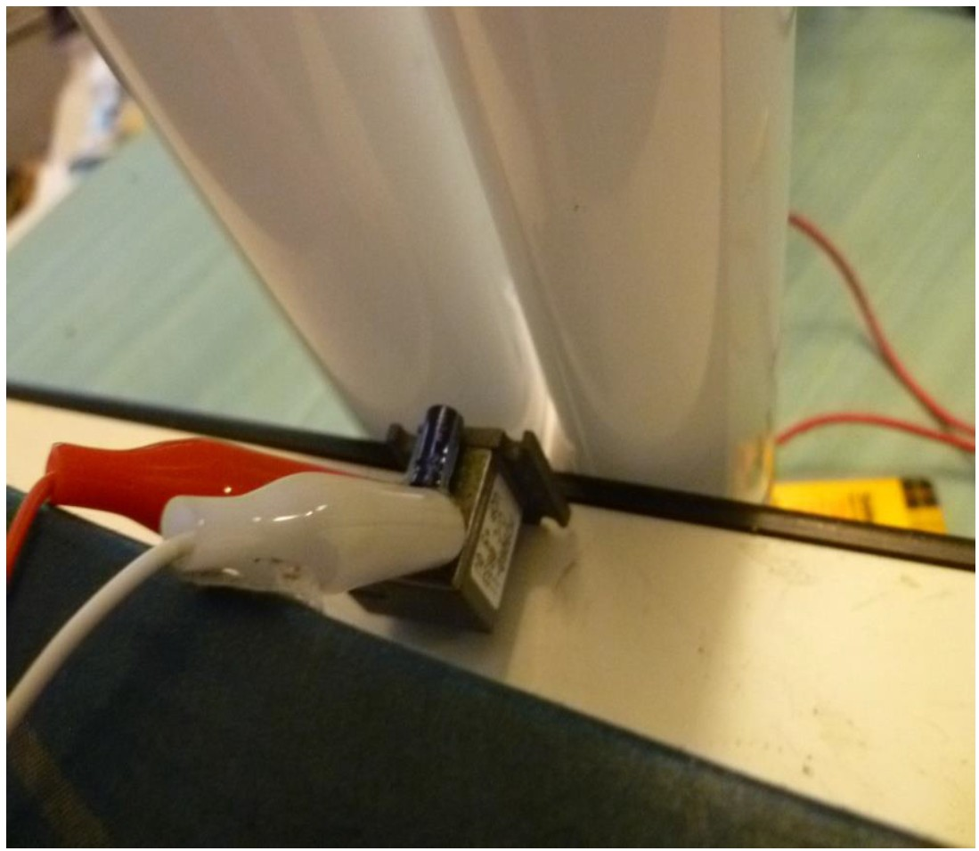
. Plasma focusing experimental setup. Gunn diode 24 GHz transmitter with fluorescent tubes
used for plasma beam focus.
Dr. Ted Anderson; Haleakala R&D;

Slide 19
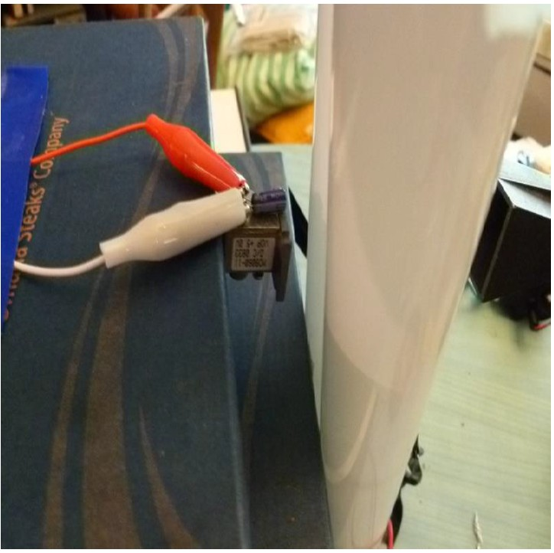
. Plasma focusing experimental setup. Gunn diode 24 GHz transmitter with fluorescent tubes
used for plasma beam focus.
Dr. Ted Anderson; Haleakala R&D;

Slide 20

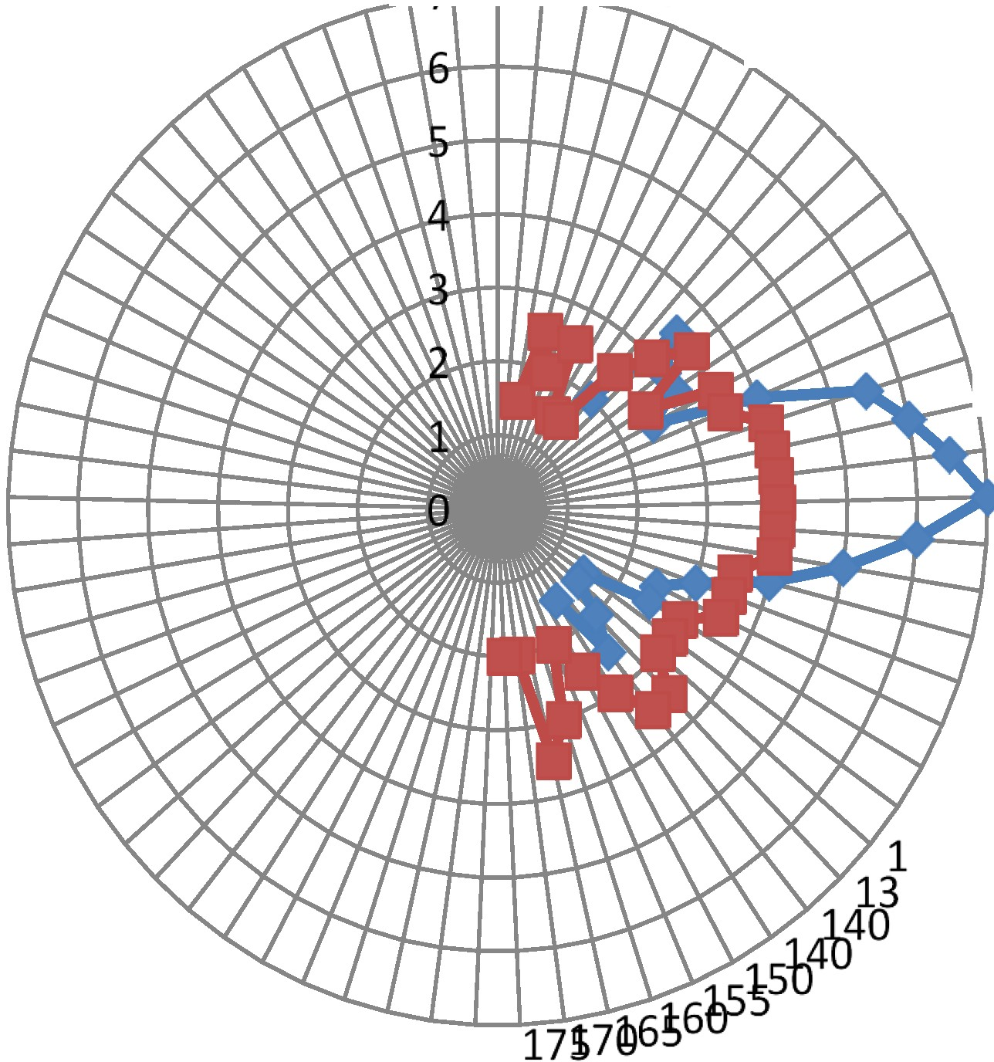
0
.l..r--r-.,..::; ,1J 01520
2 540
45_{so}
55
60
65
70
75
. 80
85
--1---t- 90
---r- 95
100
105
110
115
120
125
30
5
24 GHz beam focus with plasma. Red line is with no plasma. Blue line is with plasma. Note that the plasma focus increases beam amplitude by a factor of two compared to no plasma
(,.3 dB gain)
Dr. Ted Anderson; Haleakala R&D;

Slide 21
STEERING ANTENNA BEAMS WITH THE PHYSICS OF REFRACTION THROUGH A PLASMA
This work involved using a much higher frequency (44 GHz, 0.68 cm) and therefore shorter wavelength.
This wavelength is a factor of 5.6 smaller than the 3.8 cm tube diameter which should result in a more ideal lensing and steering action.
Dr. Ted Anderson; Haleakala R&D

Slide 22
STEERING ANTENNA BEAMS WITH THE PHYSICS OF REFRACTION THROUGH A PLASMA
The next slide shows a schematic for the experimental setup.
A 33-50 GHz HP Microwave Signal Generator is used to generate the incident microwave beam.
The plasma tube (fluorescent lamp) is placed ~1 inch in front of the open-ended waveguide, and an aluminum shield is placed against the side the tube to ensure that most of the microwave signal goes through the plasma and is not bypassed to the side of the tube.
A 33-50 GHz microwave horn with HP crystal detector is placed on a rotating arm that is scanned in an arc around the plasma tube by an antenna rotator.
The arm places the horn receiver about 16 inches from the plasma tube. This corresponds to 60 wavelengths between the steering plasma tube and the detector and clearly qualifies as far field.
Dr Ted Anderson; Haleakala R&D

Slide 23
Dr Ted Anderson; Haleakala R&D

Slide 24
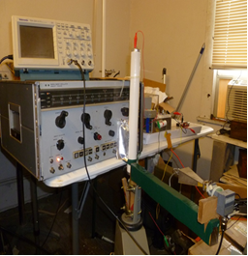
Plasma beam steering experiment at 44 GHz. Antenna rotator with holder (green) and receiver horn/detector is in the foreground. The oscilloscope used to monitor the signal waveform is on top of the HP signal generator. The solid state pulser is to the right of the signal generator.
Dr. Ted Anderson; Haleakala R&D

Slide 25
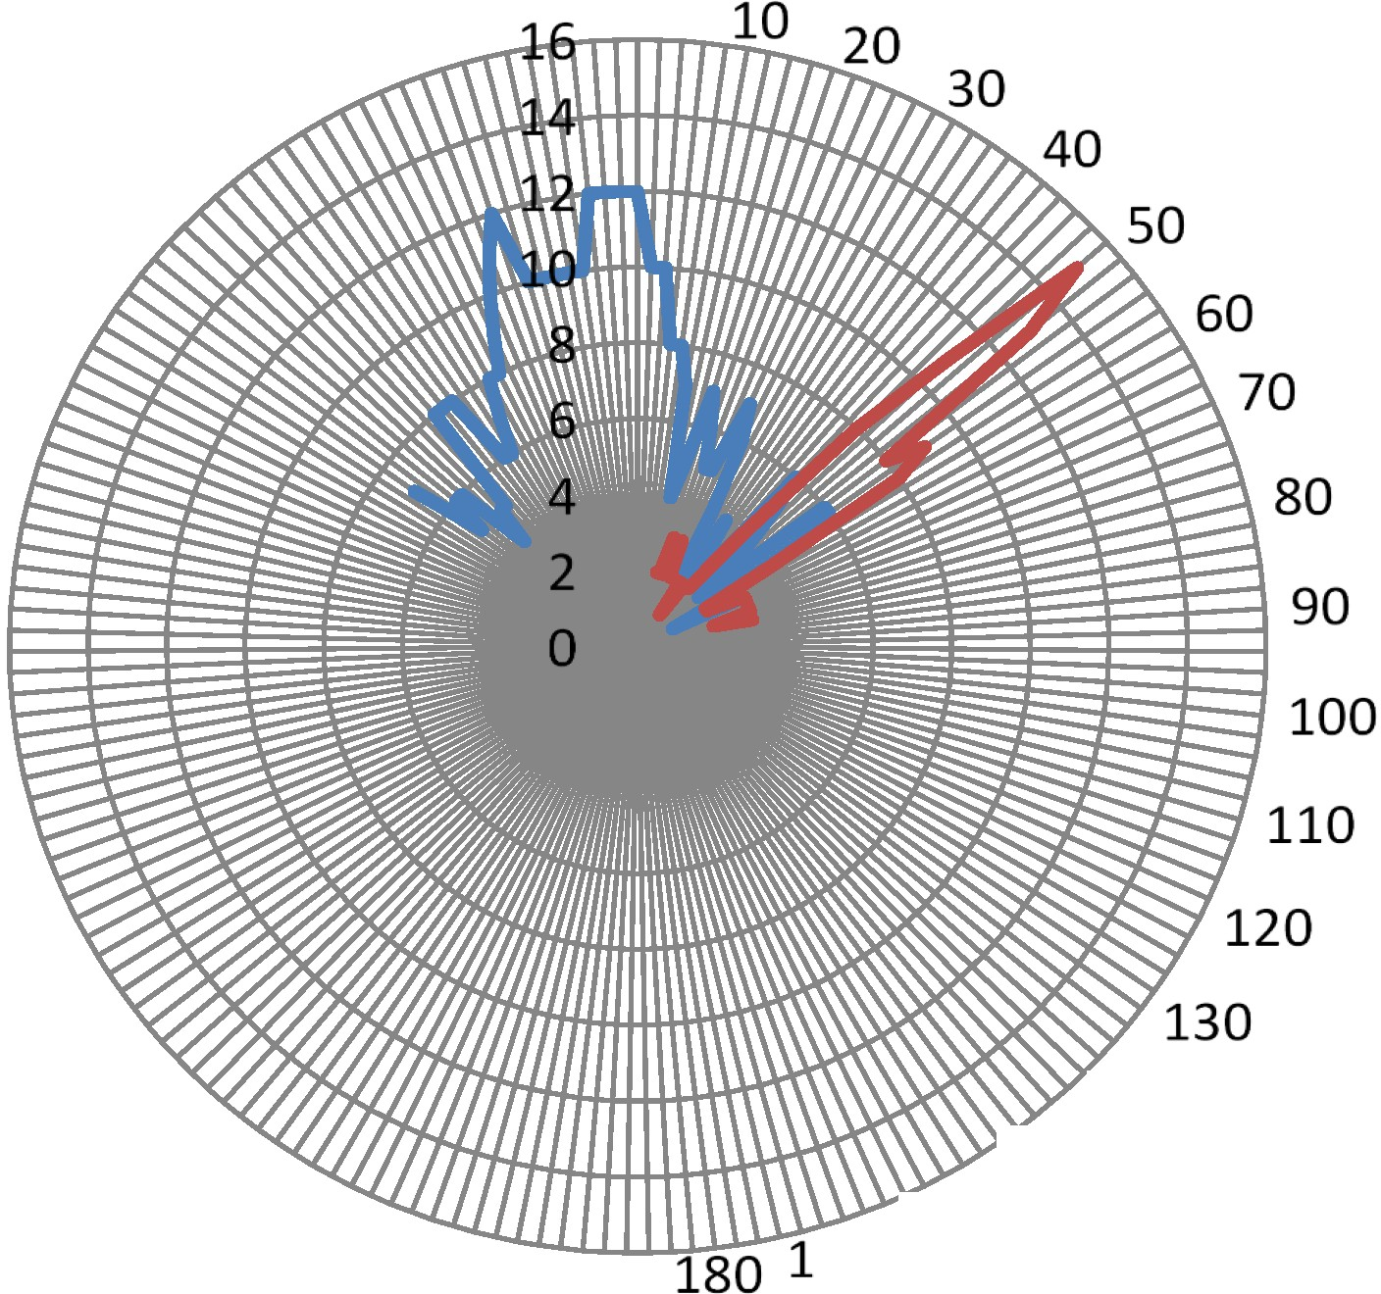
-
-
series 1 series2
140
150
70 160
Plasma Beam steering. Beam is steered 45 degrees clockwise.
Blue line: No plasma; Red line: 8 A peak ionizing current.
Dr. Ted Anderson; Haleakala R&D;

Slide 26
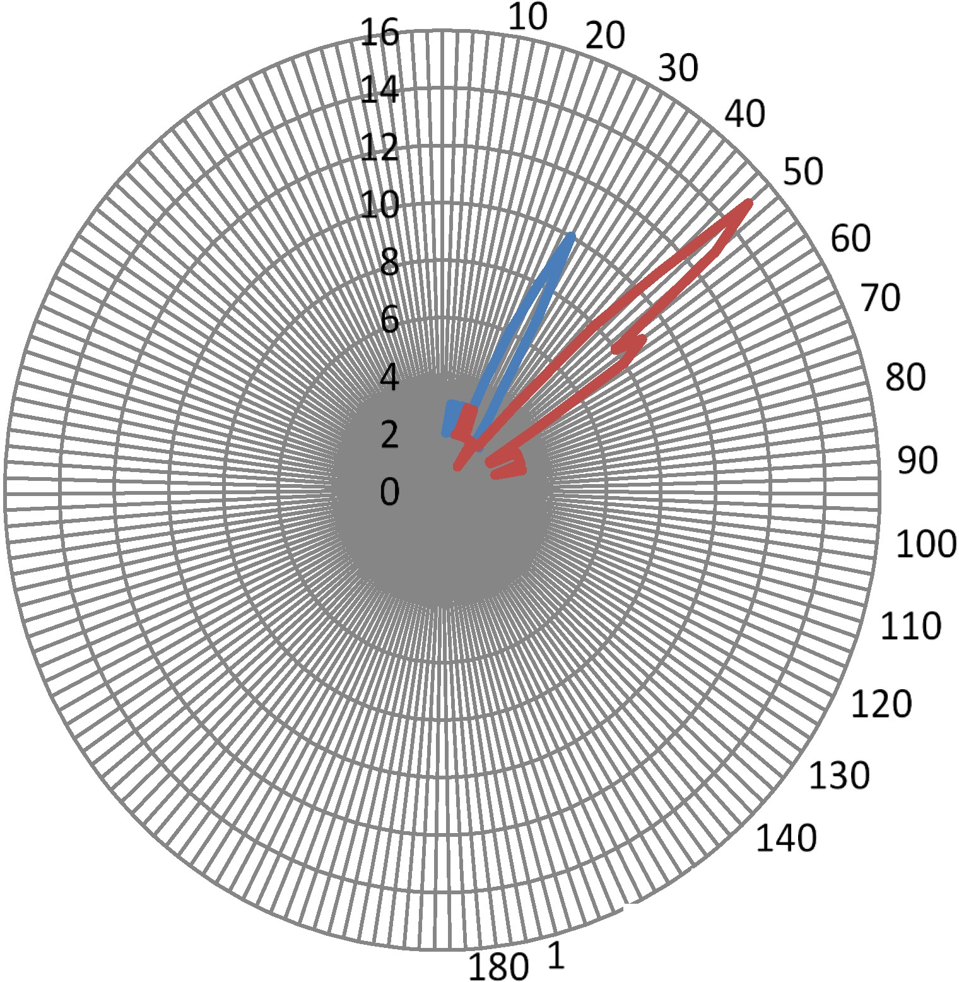
--series 1
--series 2
150
70 160
Beam steering for two different plasma ionizing currents.
Blue line: 5 A peak. Red line: 8 A peak
Dr. Ted Anderson; Haleakala R&D;

Slide 27
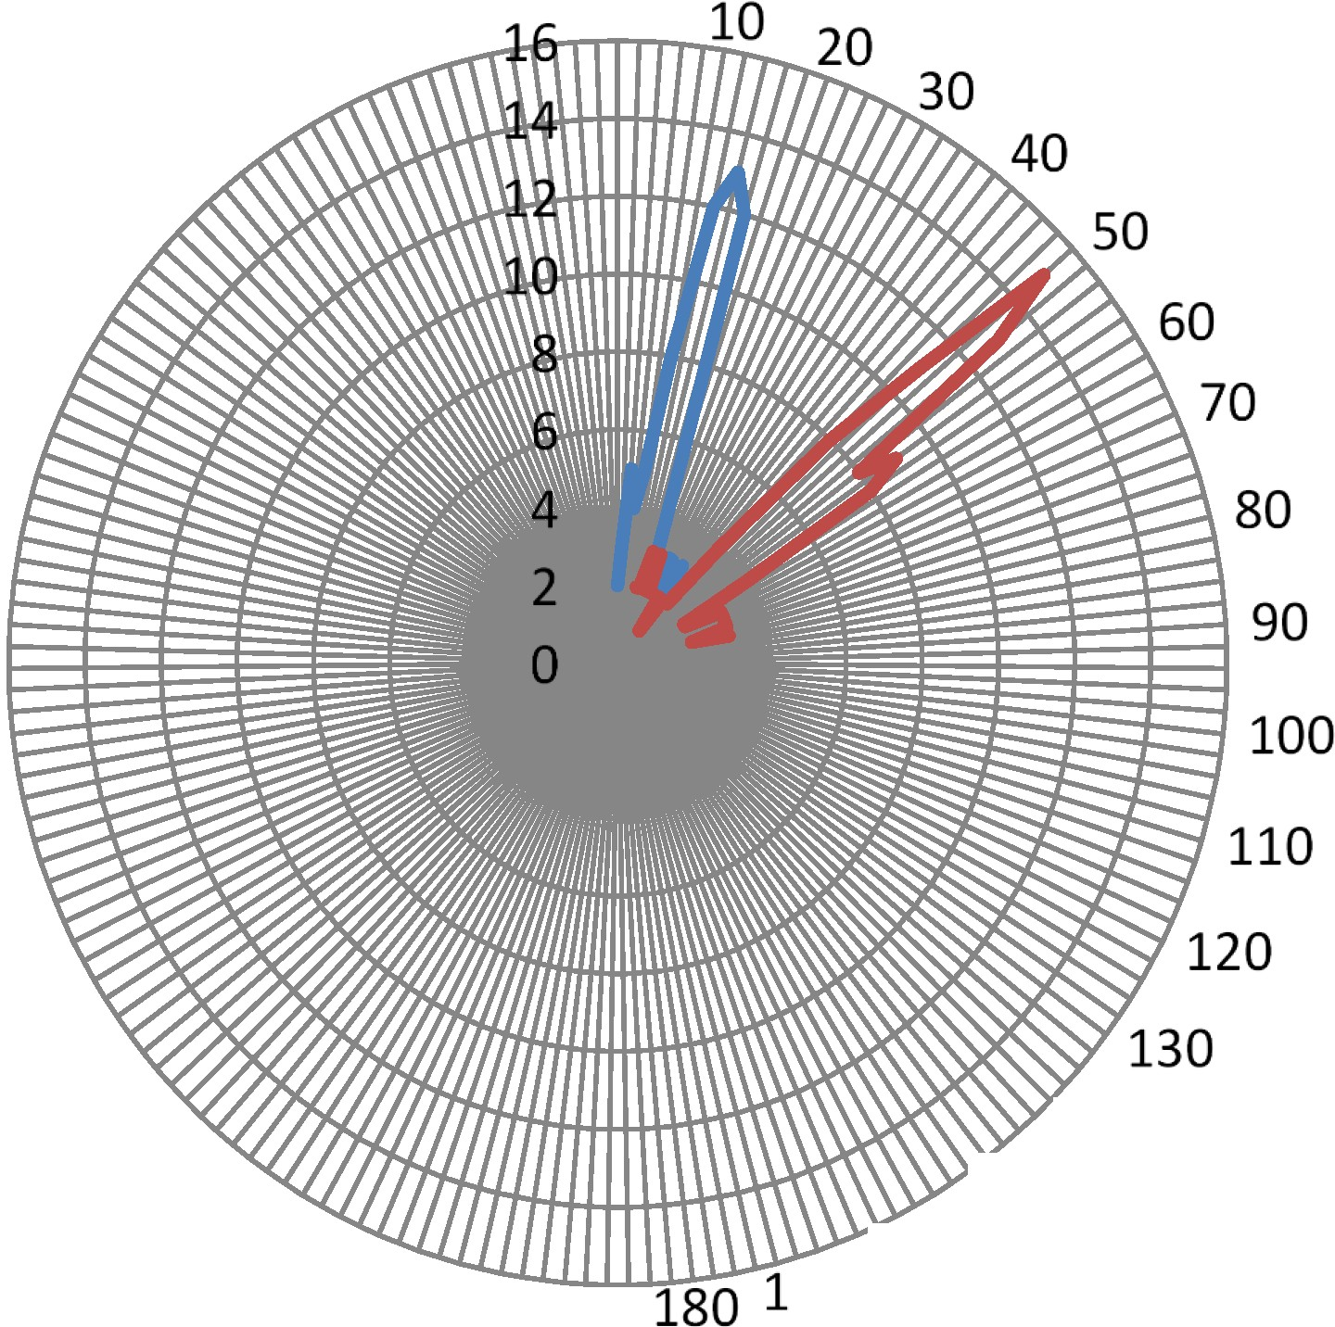
-
-
series 1
Series 2
140
150
70 160
Beam steering for two different plasma ionizing currents,
Blue line: 3 A peak. Red line: 8 A peak
Dr. Ted Anderson; Haleakala R&D;

Slide 28
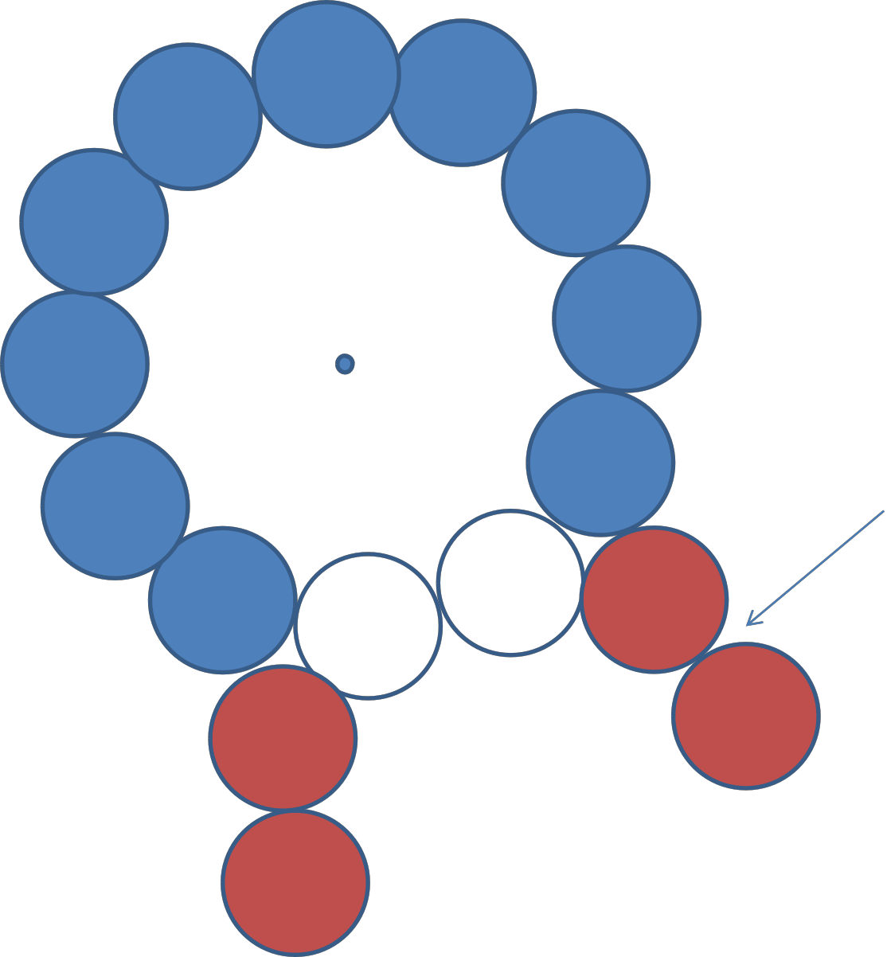
Tubes with lower density added to
focus.
Schematic of tube layout used to experiment with beam focusing of the smart plasma antennas.
Dr. Ted Anderson; Haleakala R&D;

Slide 29
Conclusions
Refraction in a plasma depends on:
  Plasma density
  Path length
  Gradient of plasma density
Focusing antenna beams was done at 24 GHz
Steering antenna beams was done at 44 GHz
We can get reconfigurable combination of focusing and steering antenna beams by using custom made plasma tubes at various:
  diameters,
  plasma frequency, or
  combinations of plasma tubes.
Dr. Ted Anderson; Haleakala R&D;

